Slide 1
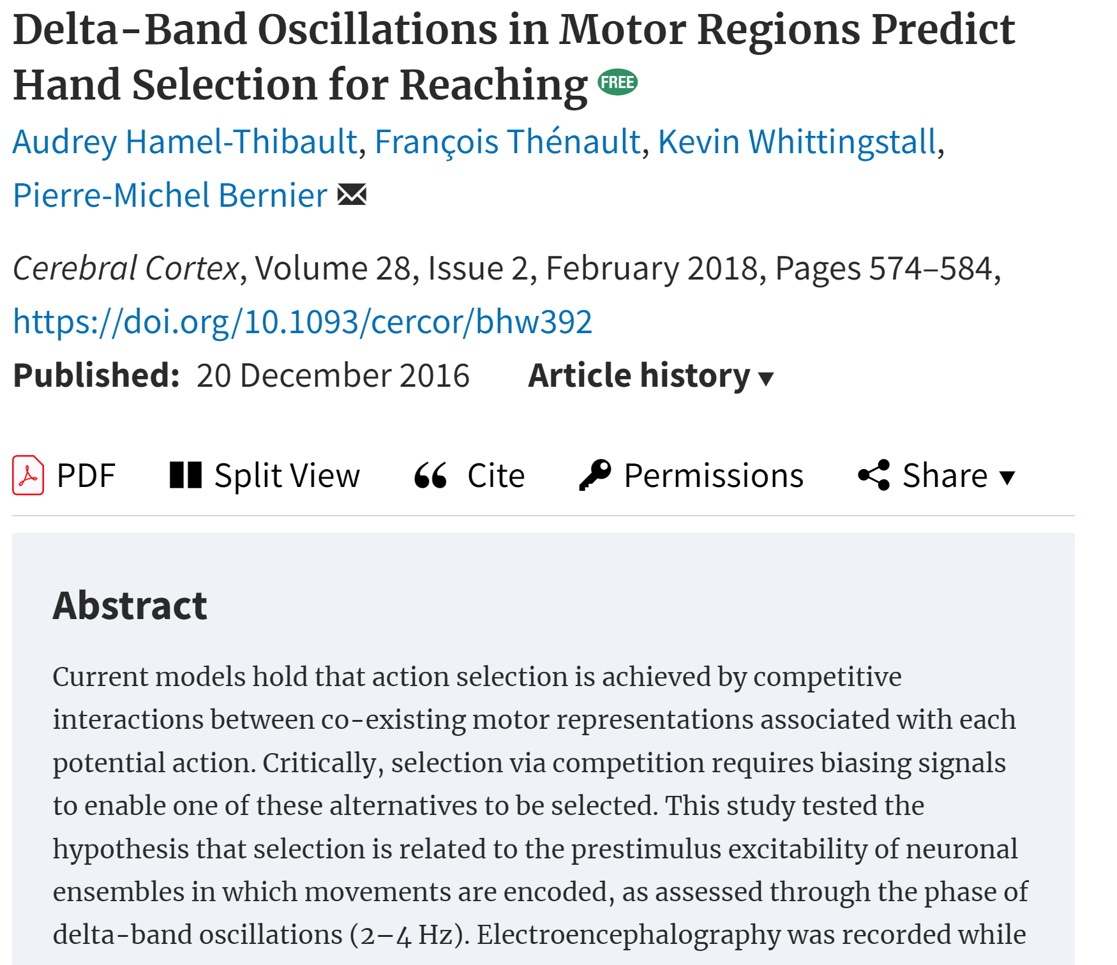
delta-band oscillations (2–4Hz) in motor regions predict hand choice
Hand selection and RT were influenced by the phase of delta oscillations at target onset
brain excitability modulates action selection ,independent of other decision factors.
*(other paper) not symmetric
Notes:
这篇文章研究了运动区域的Delta波段振荡如何预测手部选择。在实验中，参与者需要选择使用左手或右手来快速伸手触及出现的视觉目标。研究人员通过脑电图（EEG）记录了参与者的脑活动，特别关注Delta波（2–4Hz）的振荡相位，发现手部选择以及反应时间与目标出现时刻的Delta波相位强相关，尤其是在对侧的运动区域。这一研究表明，运动区域的神经元兴奋性是手部选择的一个调节因素，独立于传统的决策变量。

Slide 2
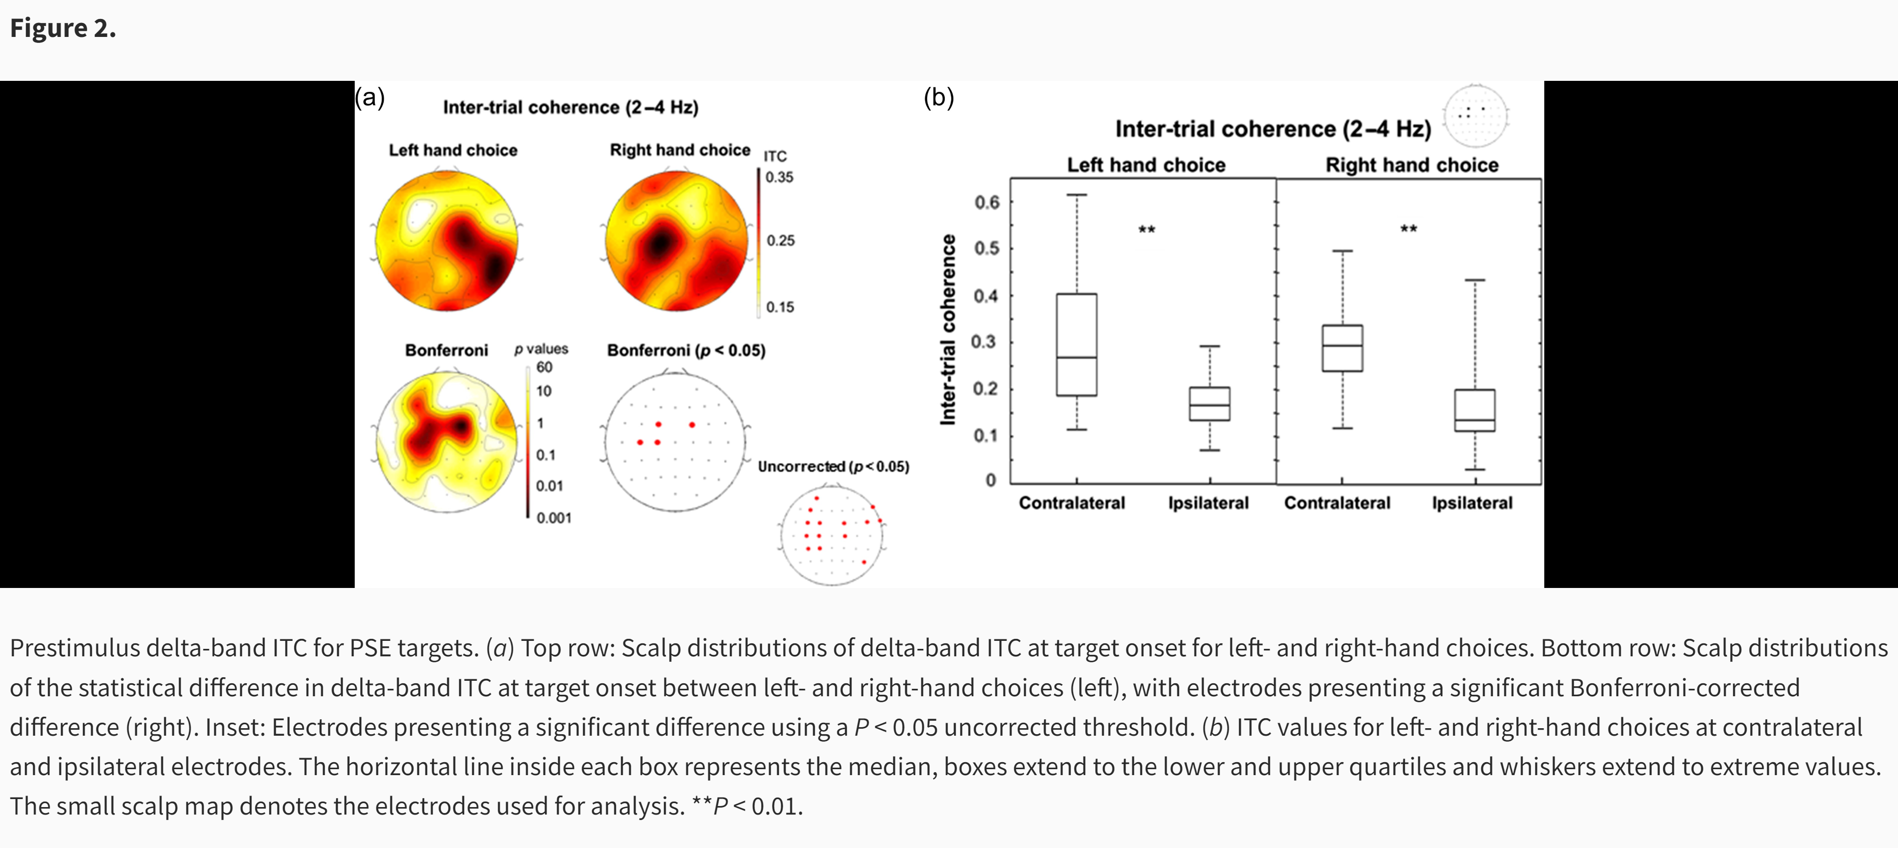
ITC for delta phase

Slide 3
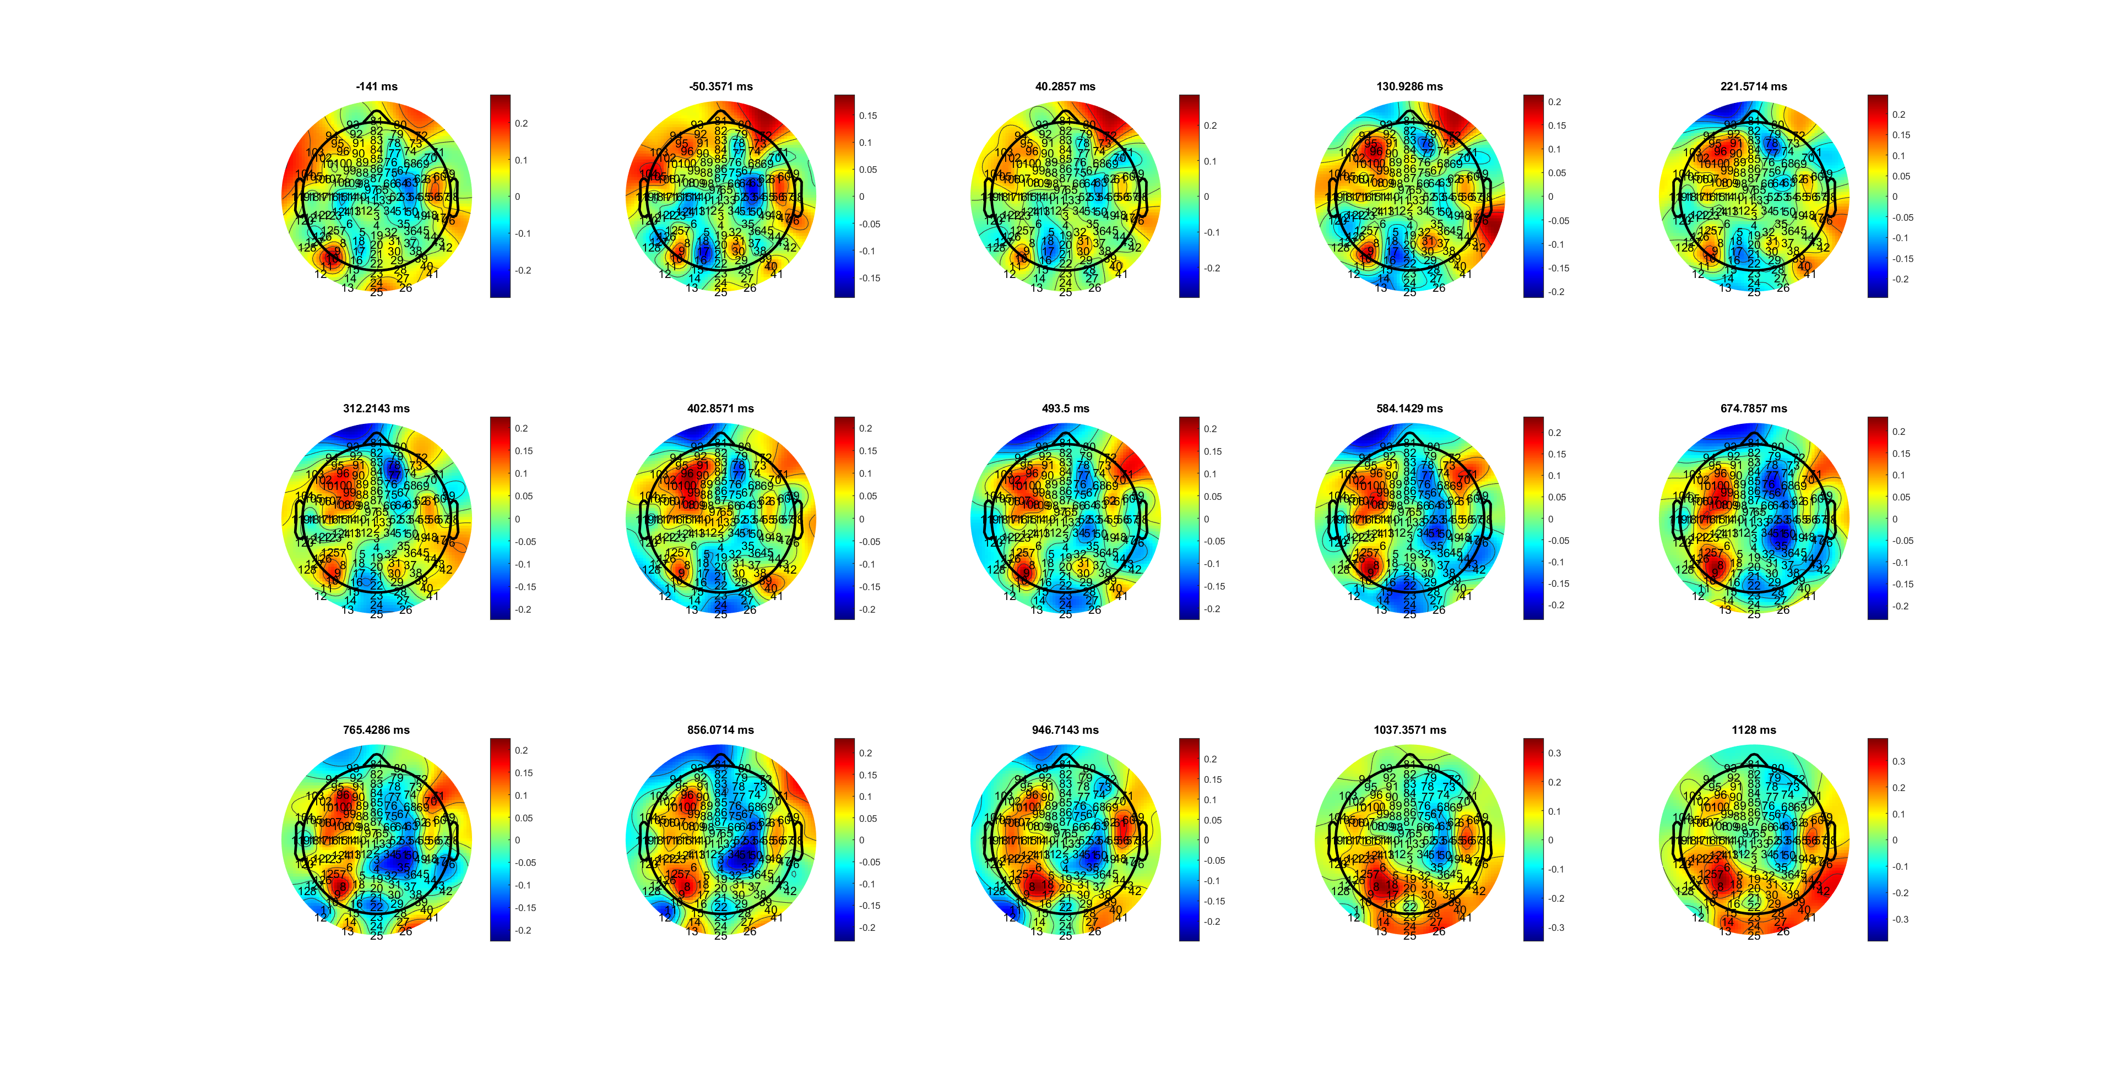
SL_High_Correct
MuBeta_SL_CR_HL.mat
Notes:
为什么两个部分,哪个是Mubeta？一个先出现一个后出现

Slide 4
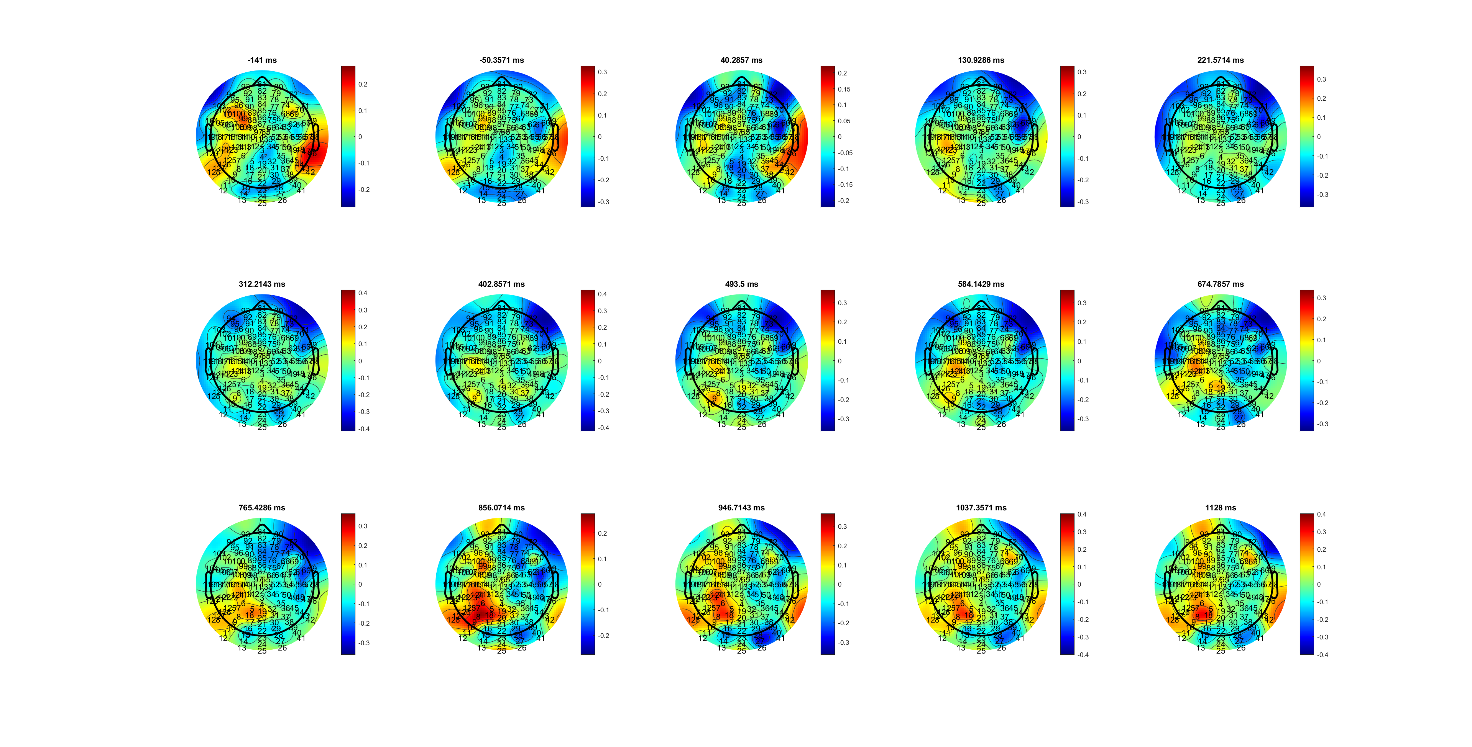
SL_Low_Correct
MuBeta_SL_CR_HL.mat

Slide 5
C34
MuBeta_SL_CR_HL.mat
Notes:
High更快
斜率不同
似乎从-600开始不同

Slide 6
C34-
MuBeta_SL_CR_HL.mat
Notes:
High更快
斜率不同
似乎从-600开始不同

Slide 7
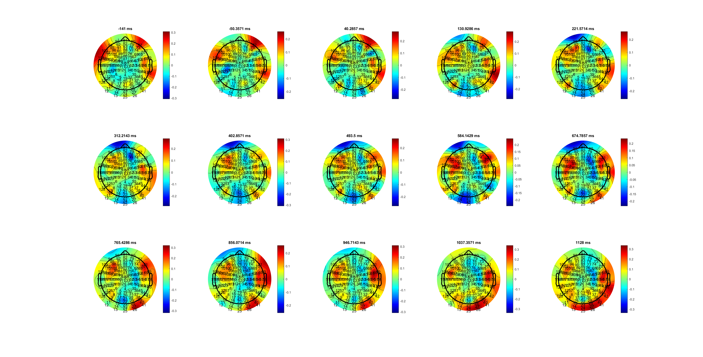
H
Beta_SL_CR_HL.mat

Slide 8
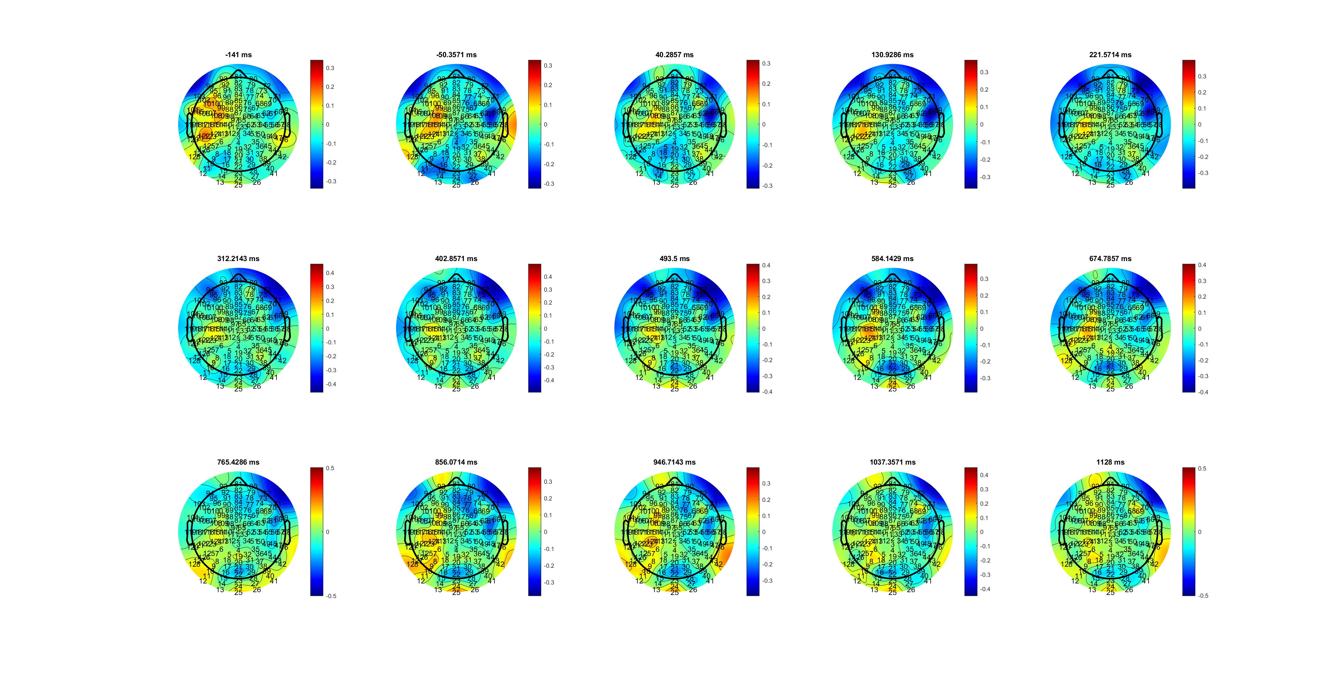
L
Beta_SL_CR_HL.mat

Slide 9
C34
Beta_SL_CR_HL.mat

Slide 10
AVG C34
Beta_SL_CR_HL.mat
Notes:
High更快
斜率不同
似乎从-600开始不同（Low更快启动）

Slide 11
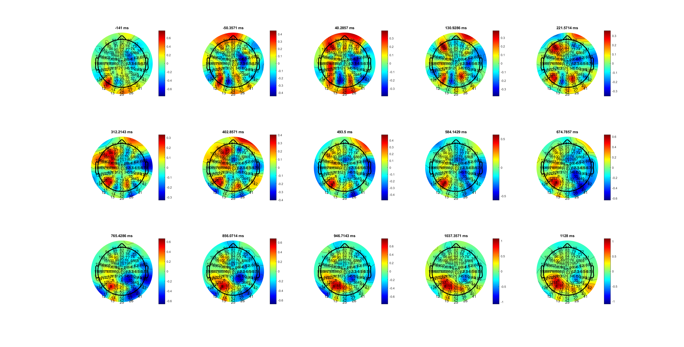
H
Mu_SL_CR_HL.mat

Slide 12
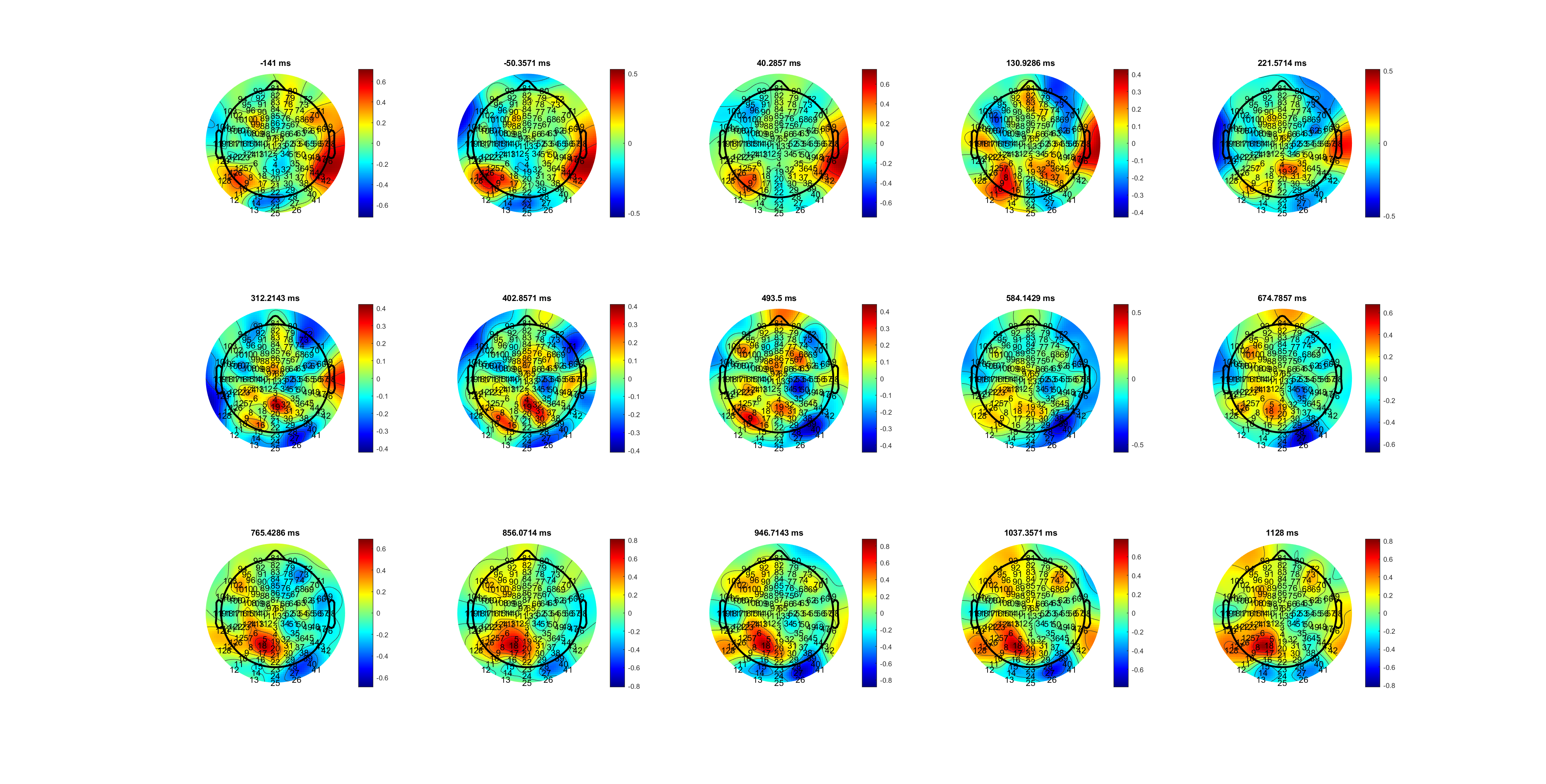
L
Mu_SL_CR_HL.mat

Slide 13
AVG C34
Mu_SL_CR_HL.mat

Slide 14
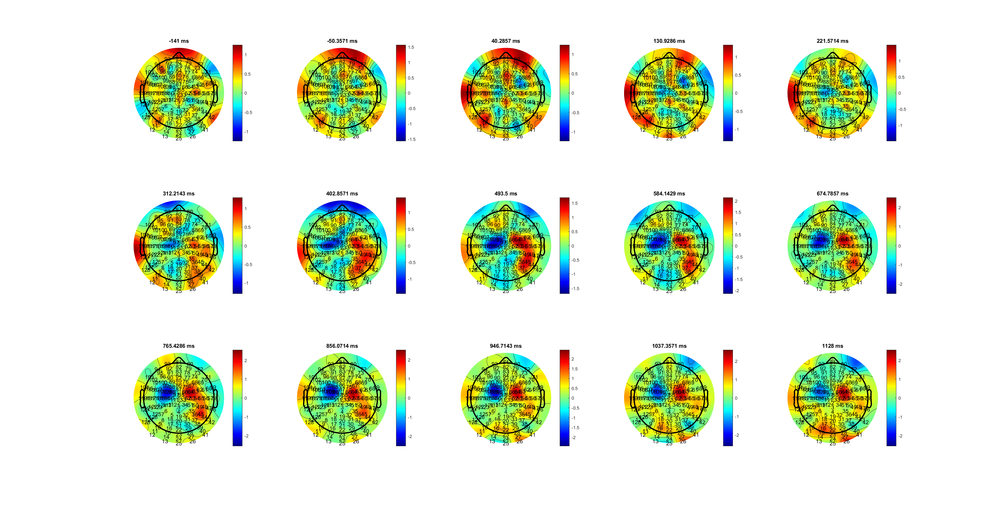
H Delta （theta not that observious）
Delta_SL_CR_HL.mat

Slide 15
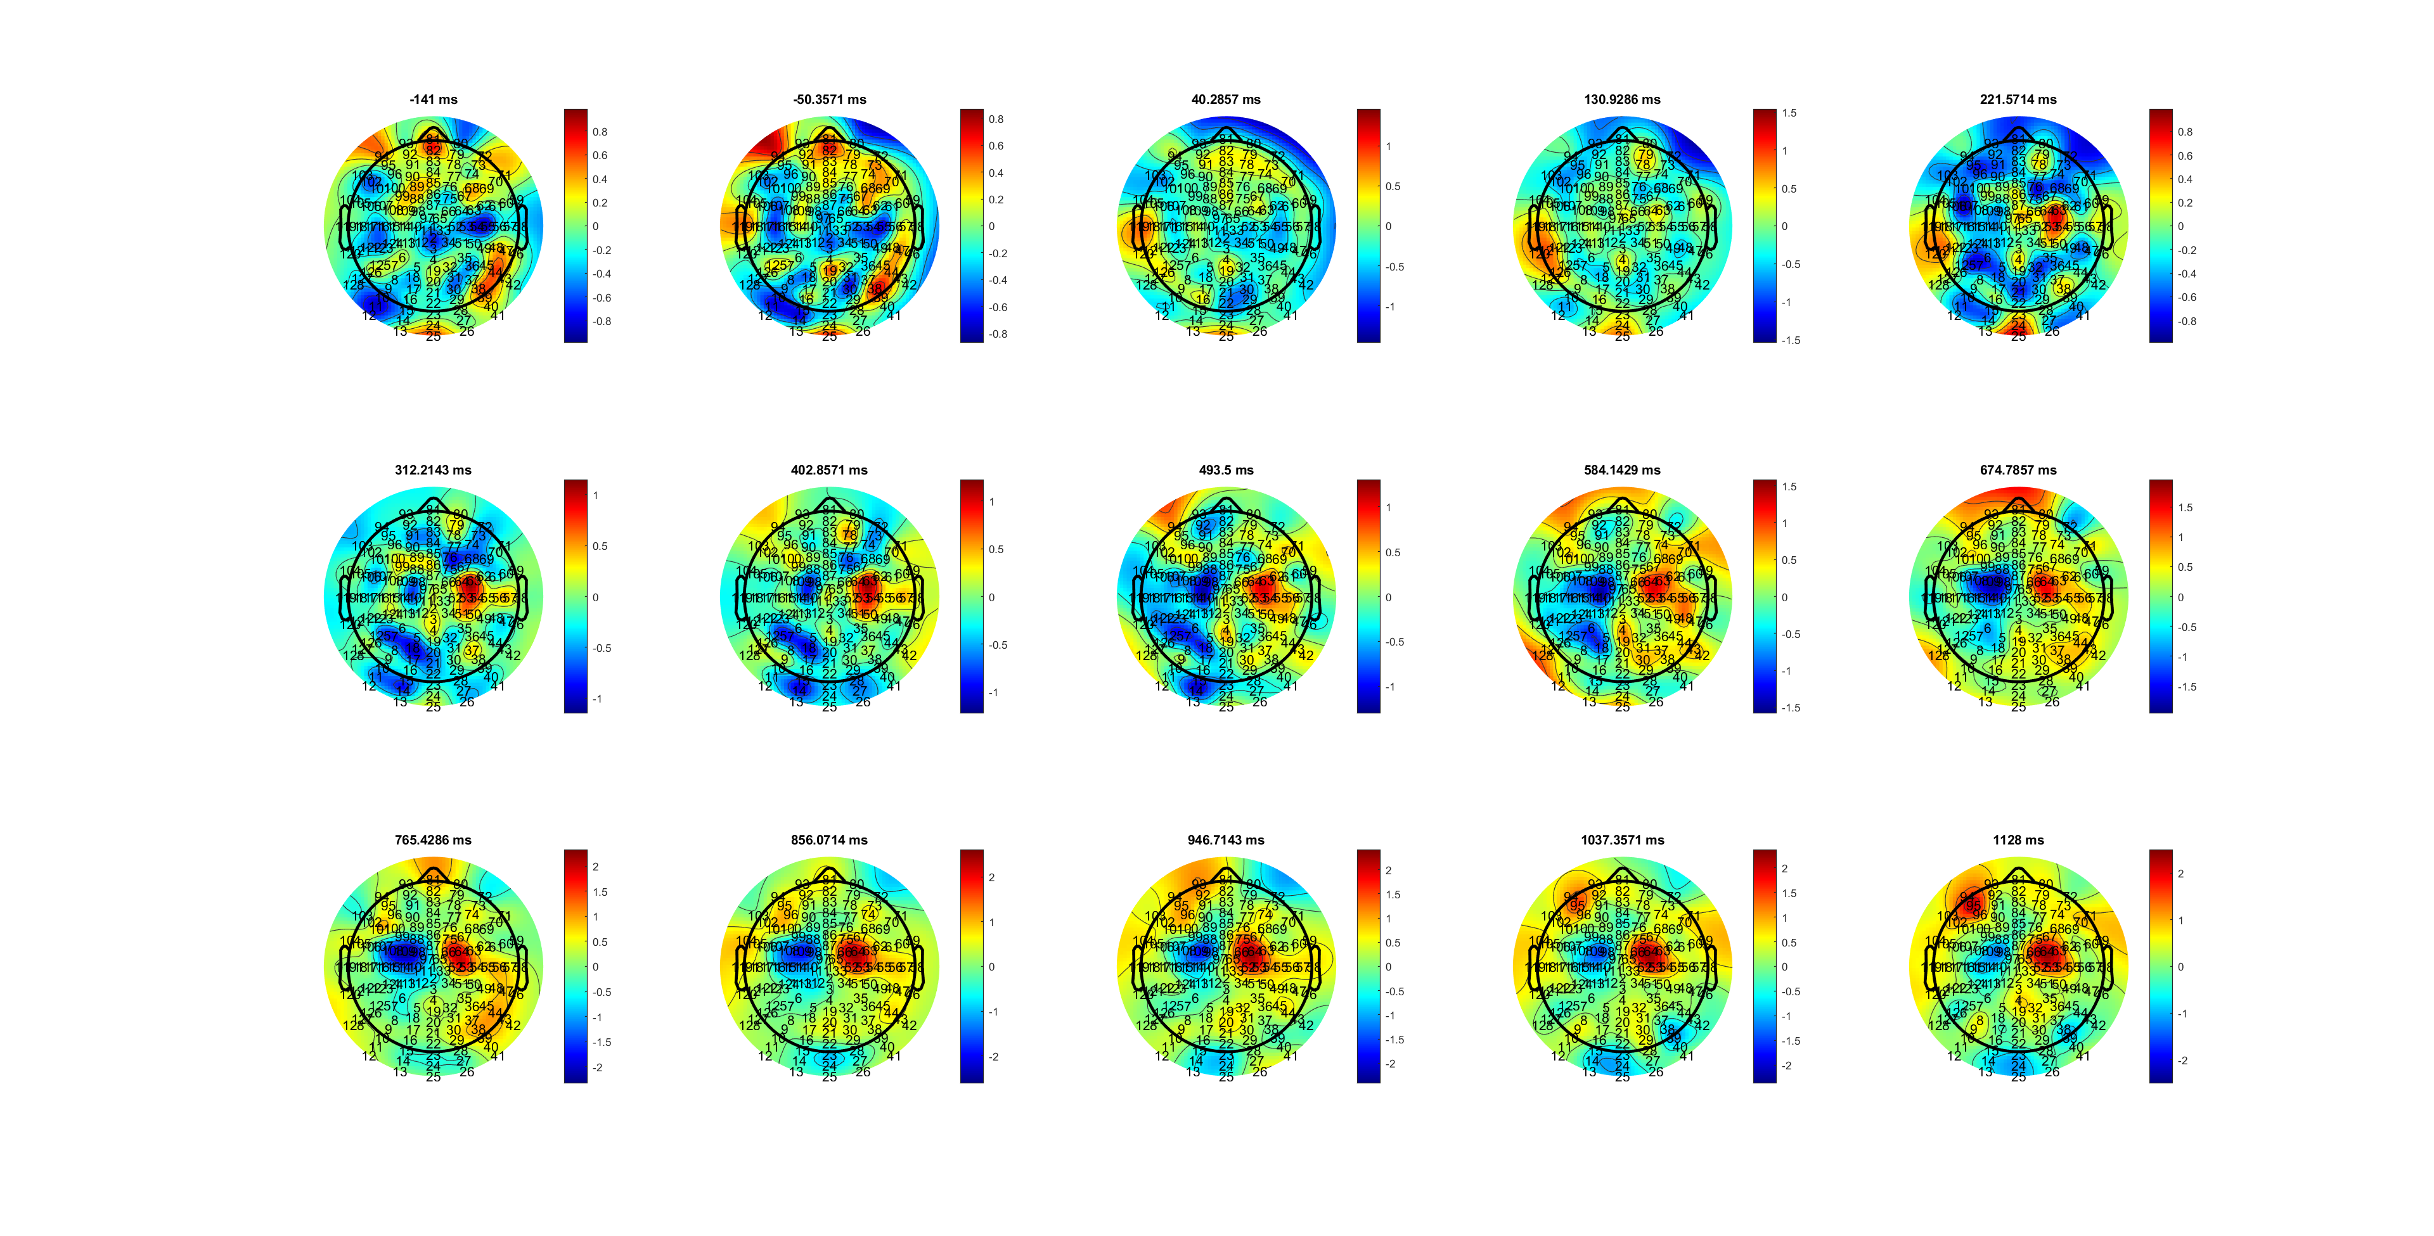
L Delta
Delta_SL_CR_HL.mat

Slide 16
C34
Delta_SL_CR_HL.mat

Slide 17
AVG C34 Delta
Delta_SL_CR_HL.mat
Notes:
更明显？？

Slide 18
FDIBCP _SL

Slide 19
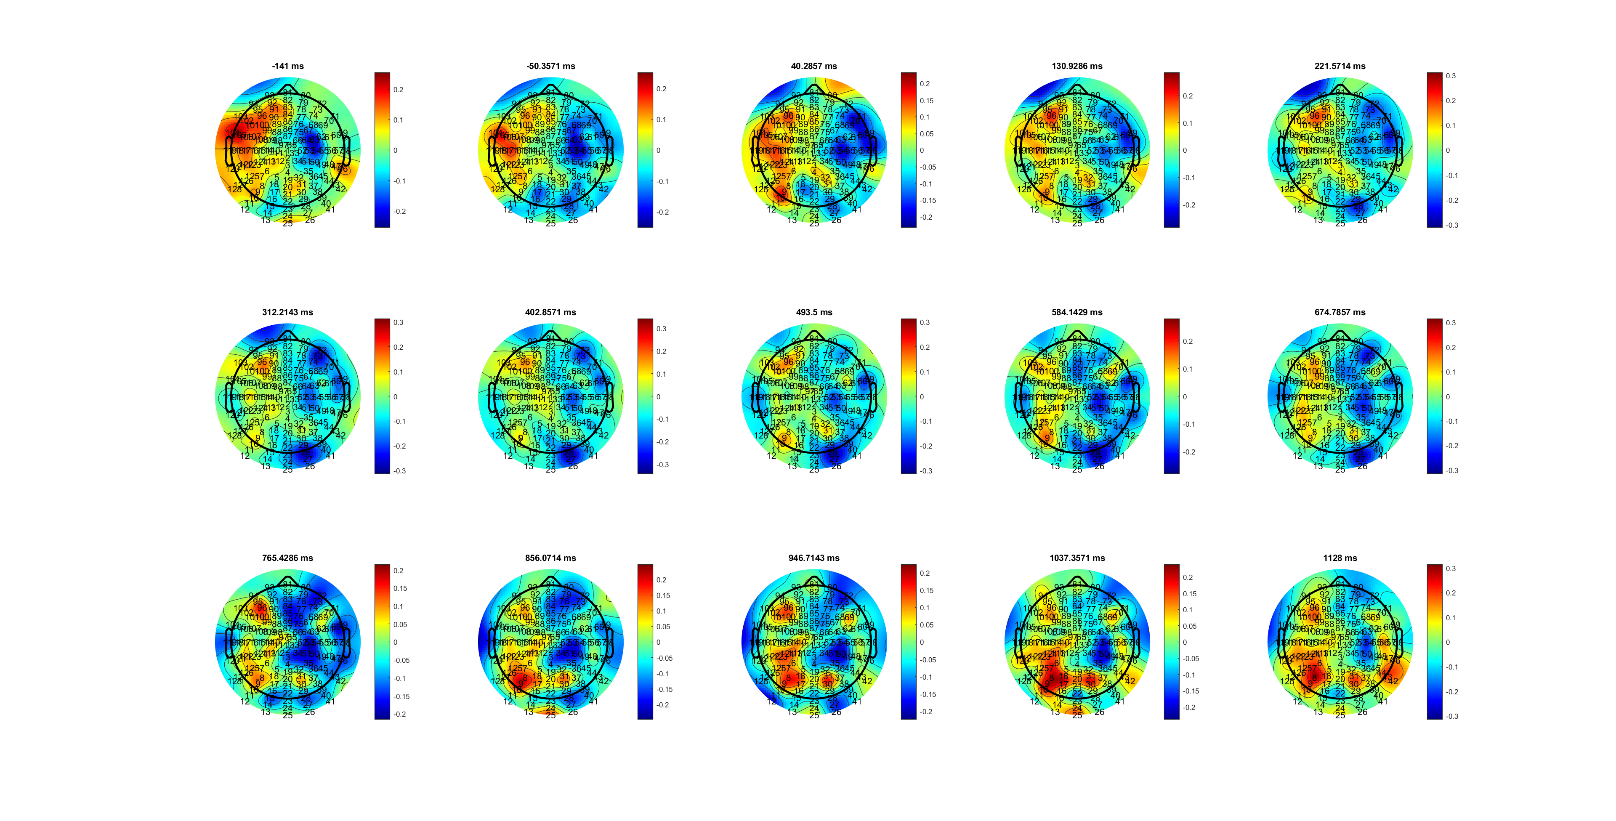
FDI
MuBeta_SL_CR_FDIBCP.mat

Slide 20
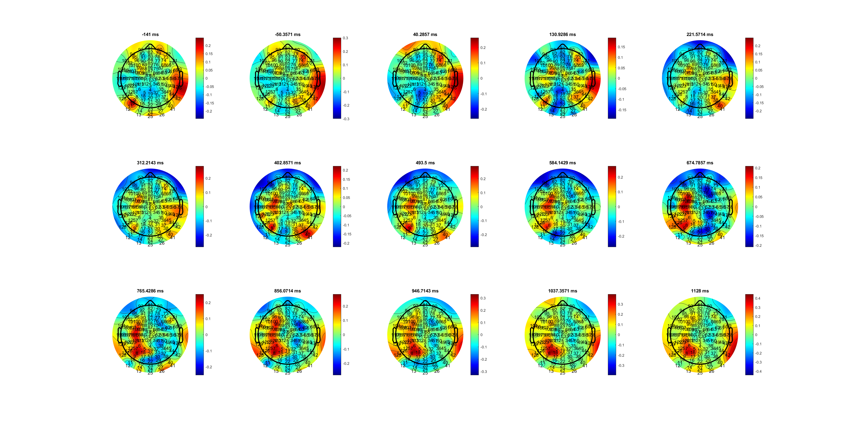
BCP
MuBeta_SL_CR_FDIBCP.mat

Slide 21
AVG C34 Mubeta
MuBeta_SL_CR_FDIBCP.mat
Notes:
BCP contr 和ilp 反应不同且慢

Slide 22
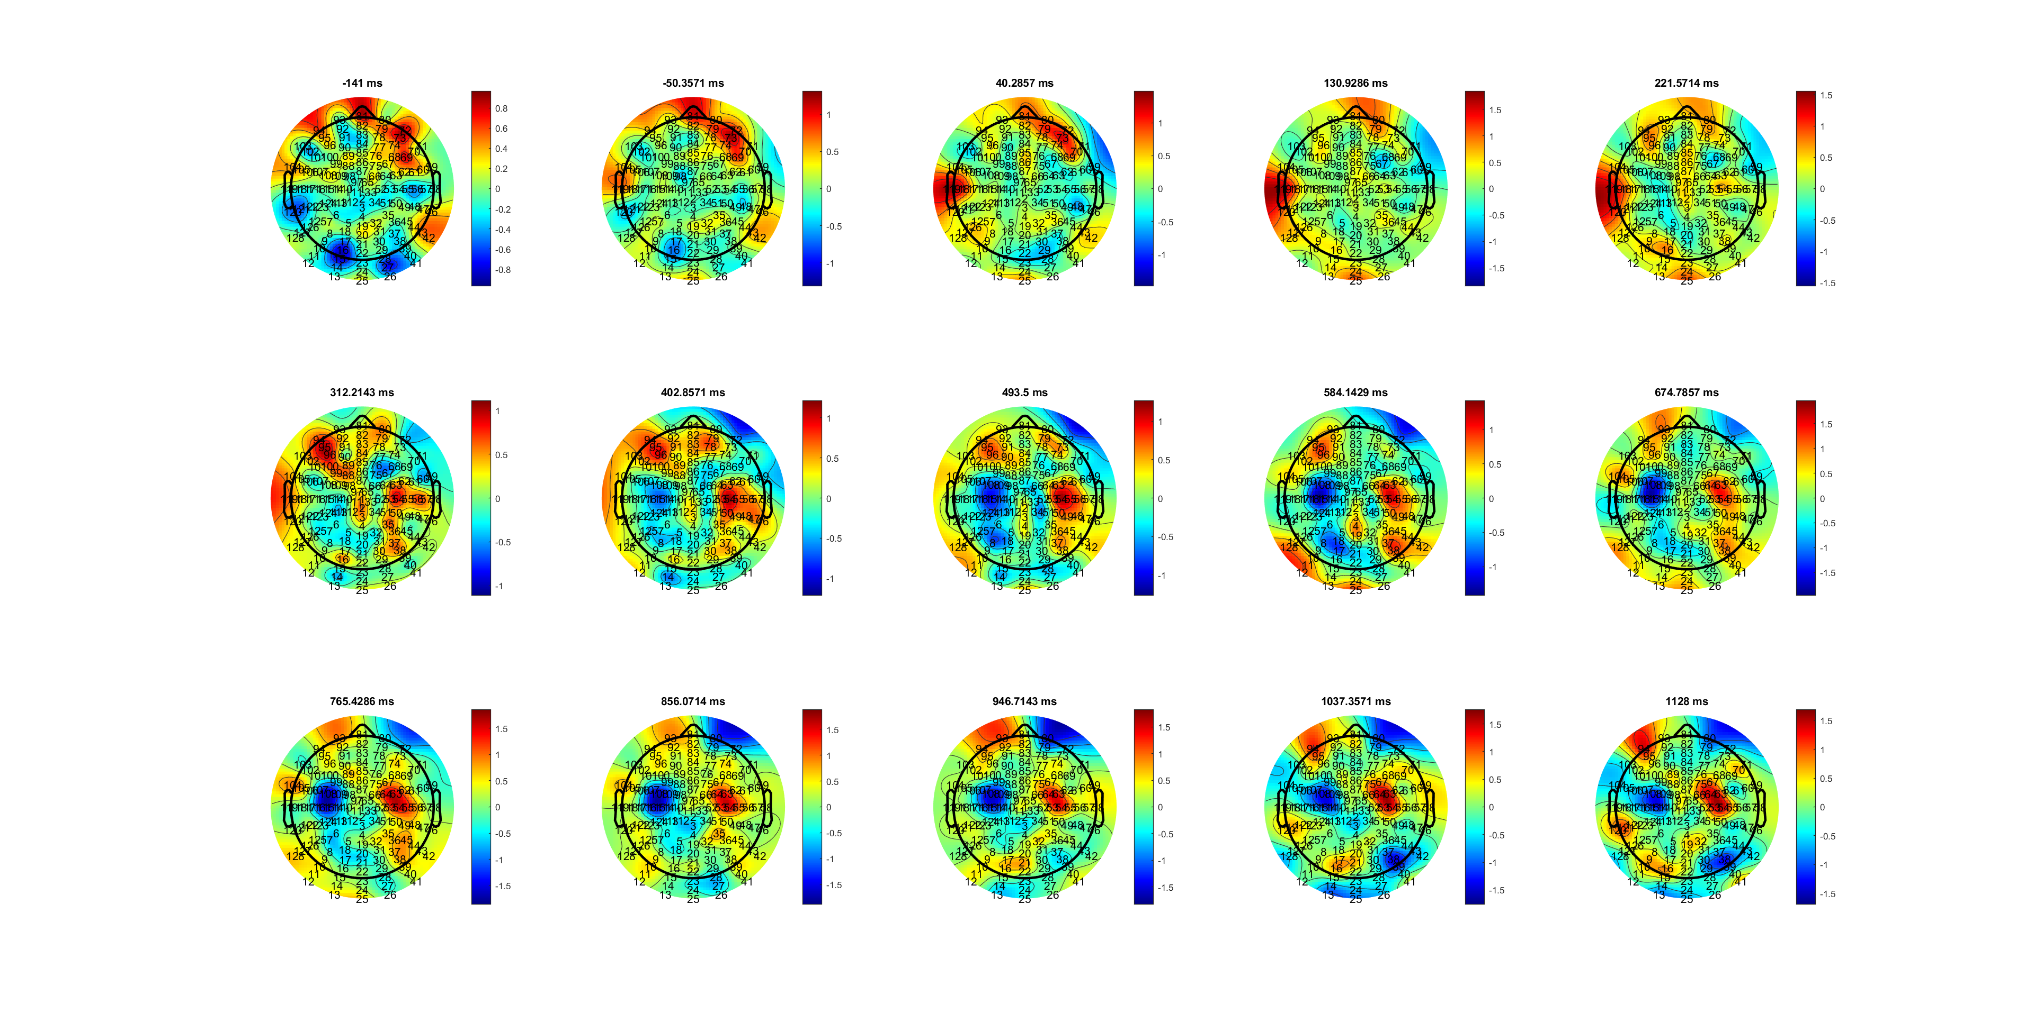
FDI (wider!!!)
Delta_SL_CR_FDIBCP.mat

Slide 23
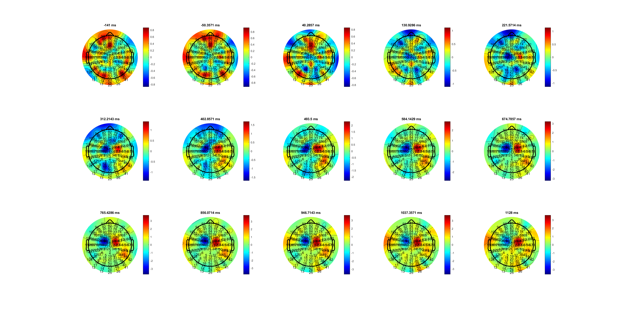
BCP (narrower!!)
Delta_SL_CR_FDIBCP.mat

Slide 24
AVG C34 Delta (how to find a way better select FDI and BCP channel)
Delta_SL_CR_FDIBCP.mat

Slide 25
EOL

Slide 26
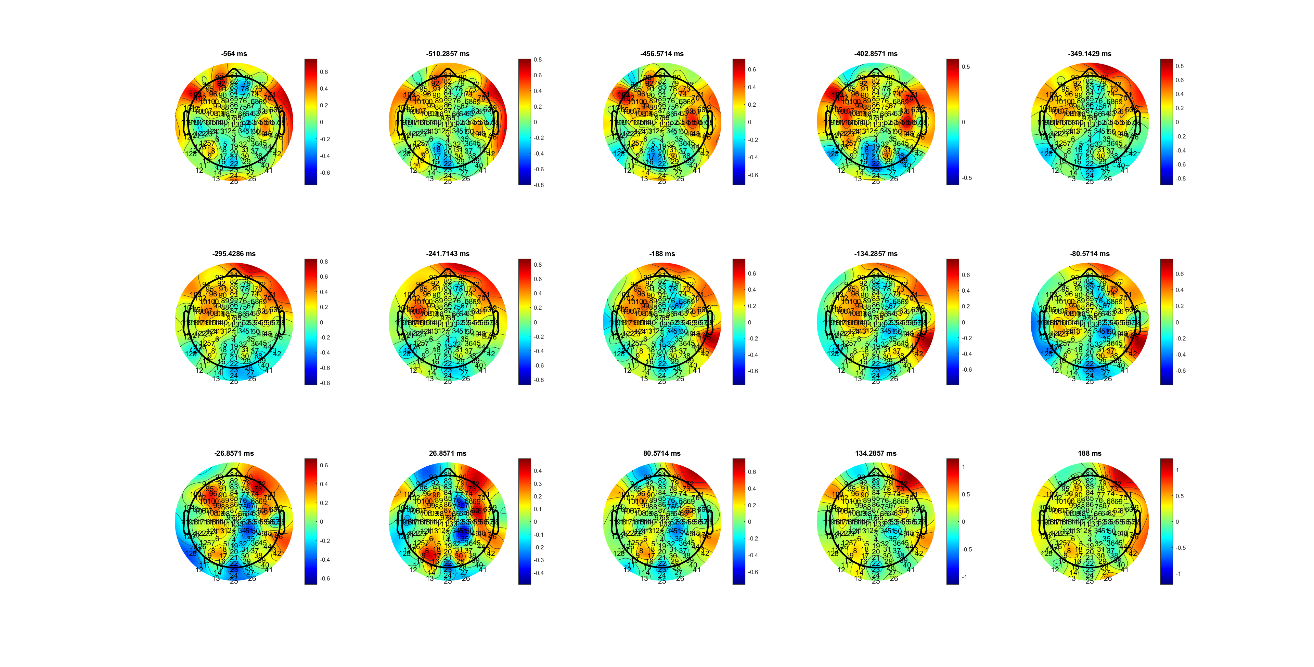
EOL_H
MuBeta_EOL_HL.mat

Slide 27
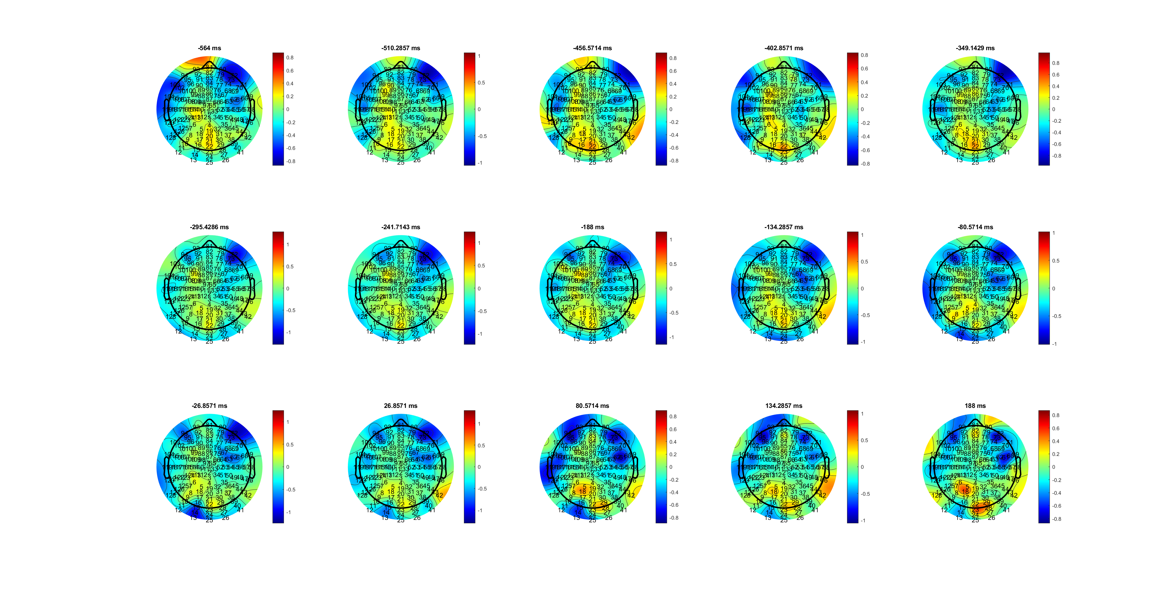
EOL_L
MuBeta_EOL_HL.mat

Slide 28
AVG C34
MuBeta_EOL_HL.mat

Slide 29
Updated RL 23Oct2024

Slide 30
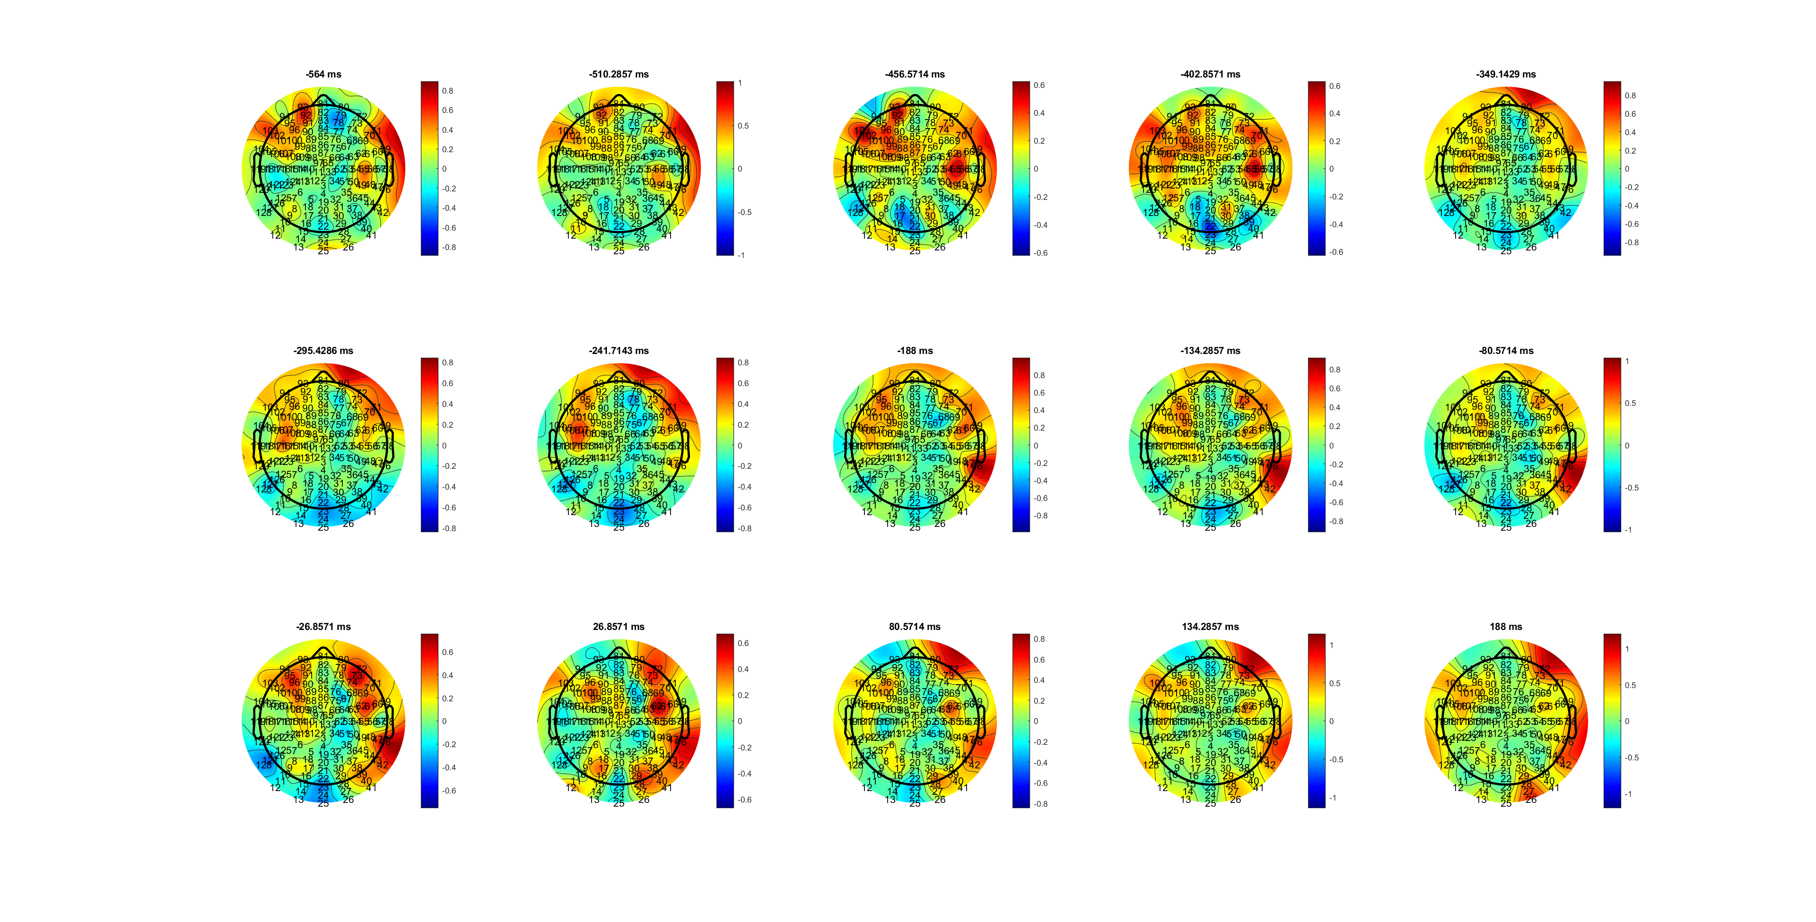
H
Beta_EOL_HL.mat

Slide 31
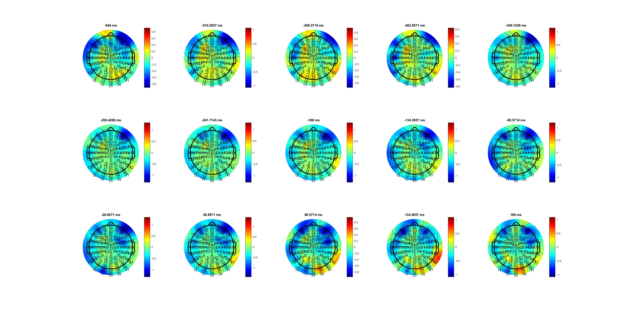
L
Beta_EOL_HL.mat

Slide 32
Beta_EOL_HL.mat

Slide 33
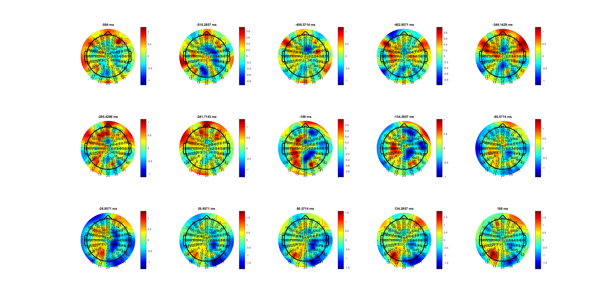
H
Mu_EOL_HL.mat

Slide 34
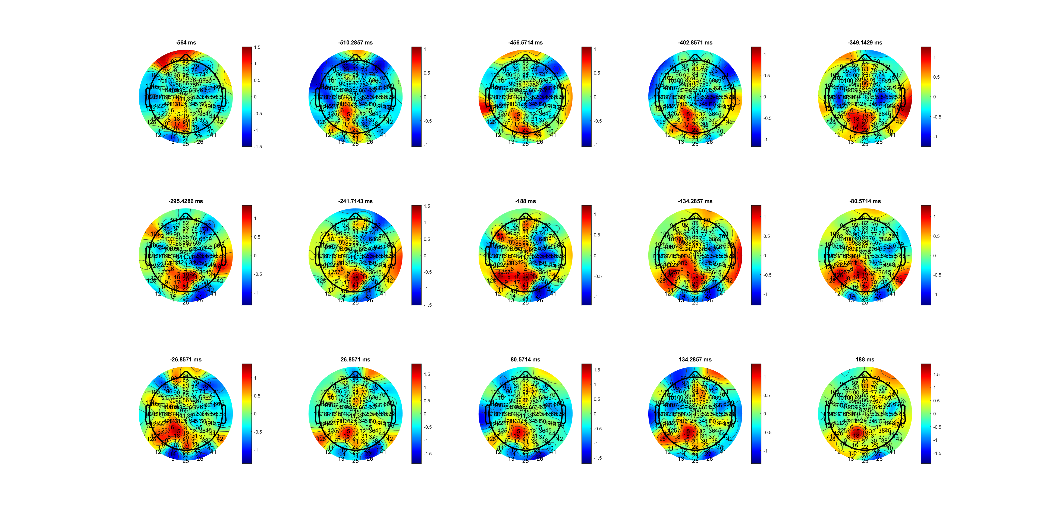
L
Mu_EOL_HL.mat

Slide 35
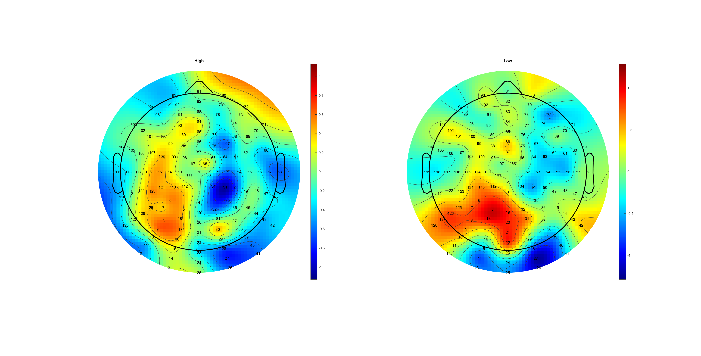
Mu_EOL_HL.mat

Slide 36
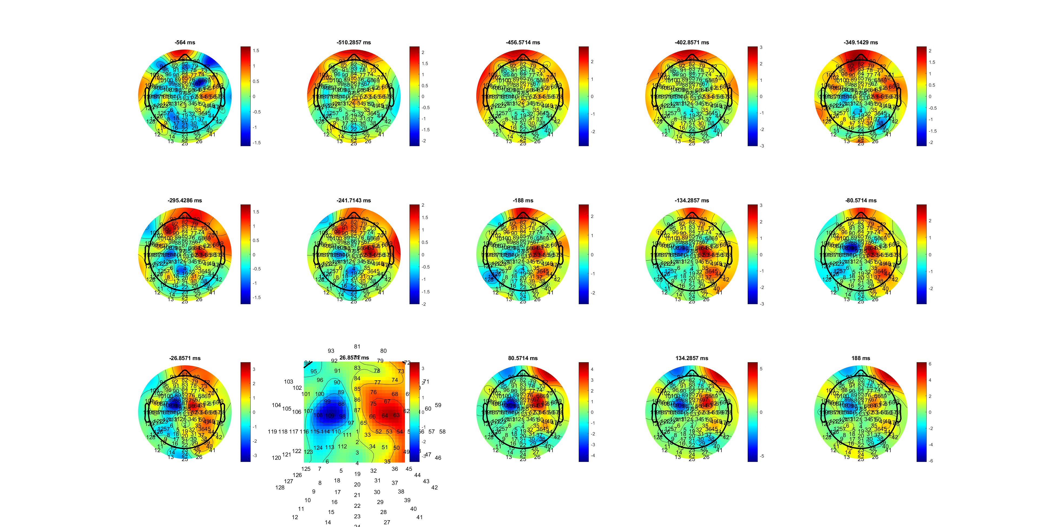
H
Delta_EOL_HL.mat

Slide 37
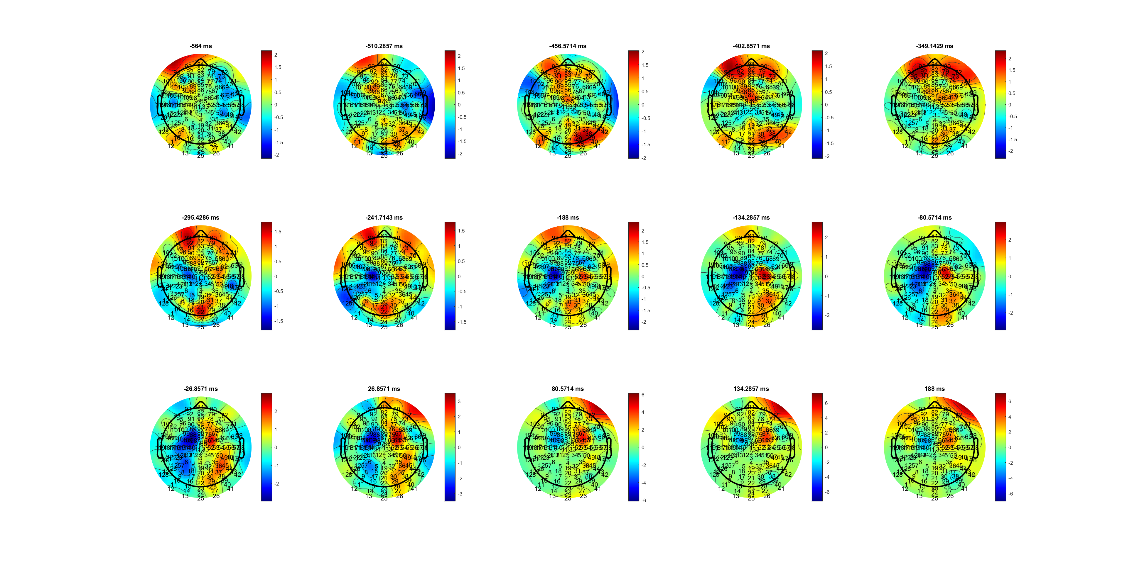
L
Delta_EOL_HL.mat

Slide 38
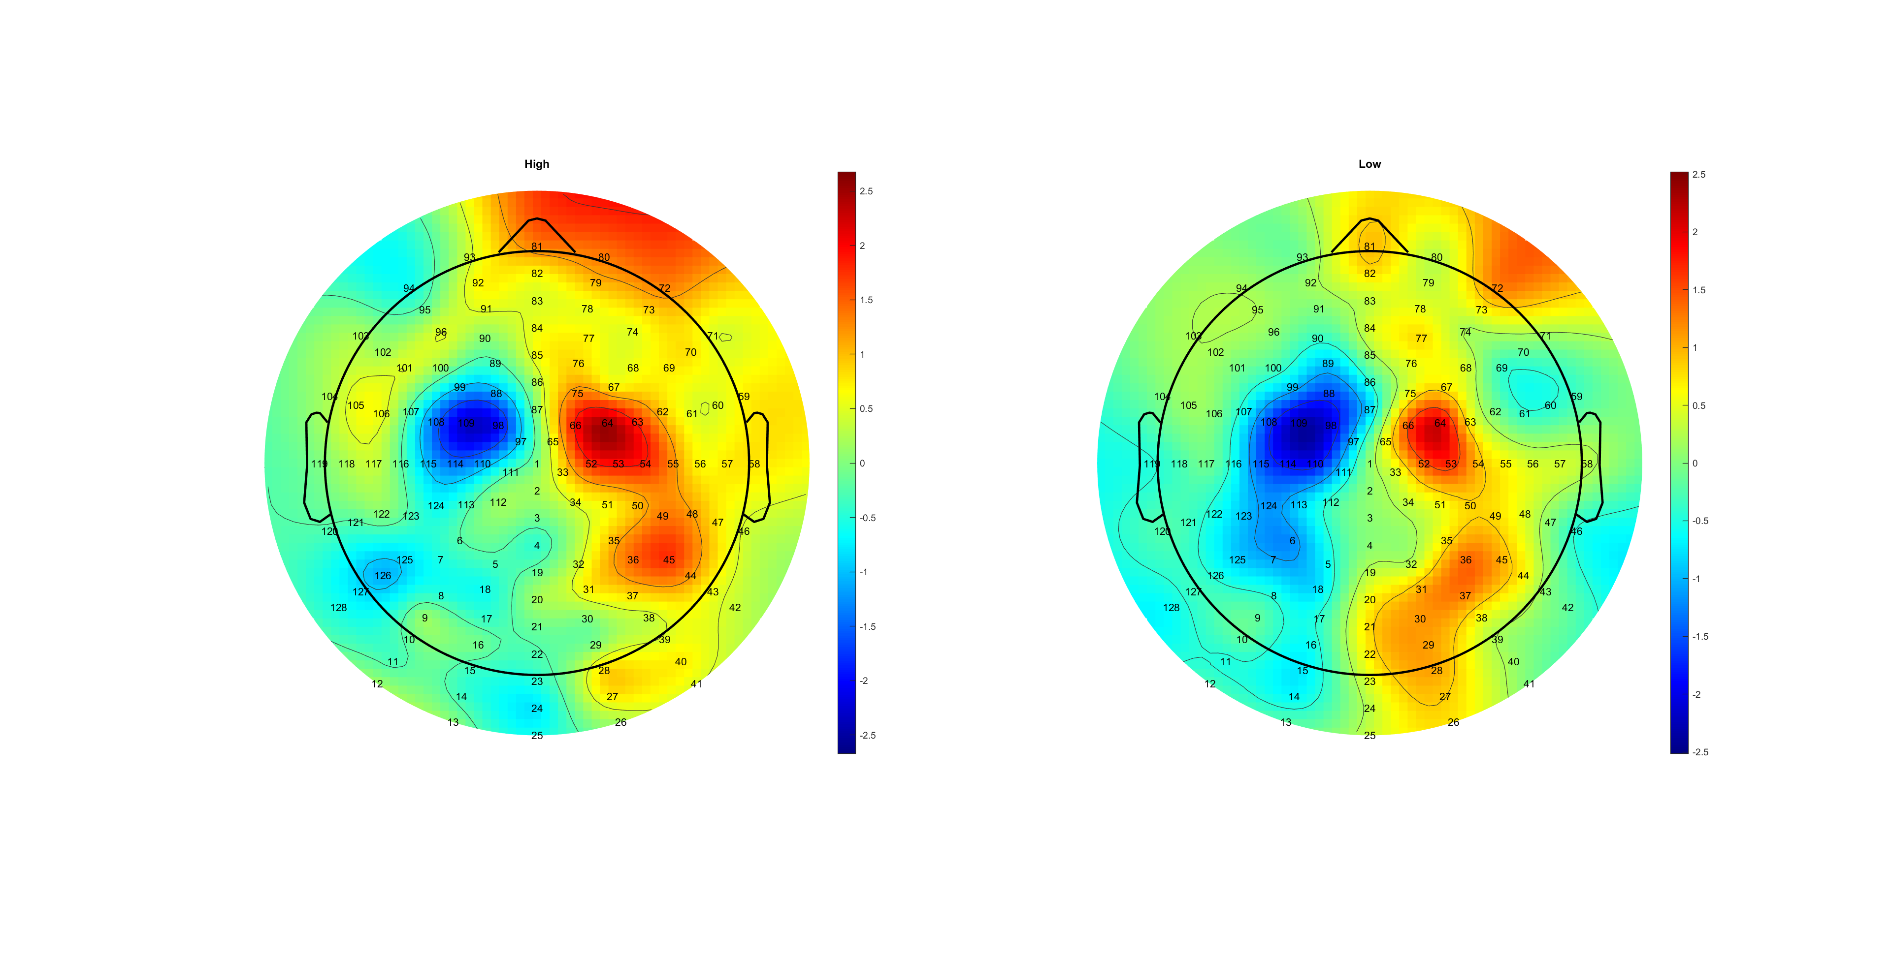
AVG C34
Delta_EOL_HL.mat

Slide 39
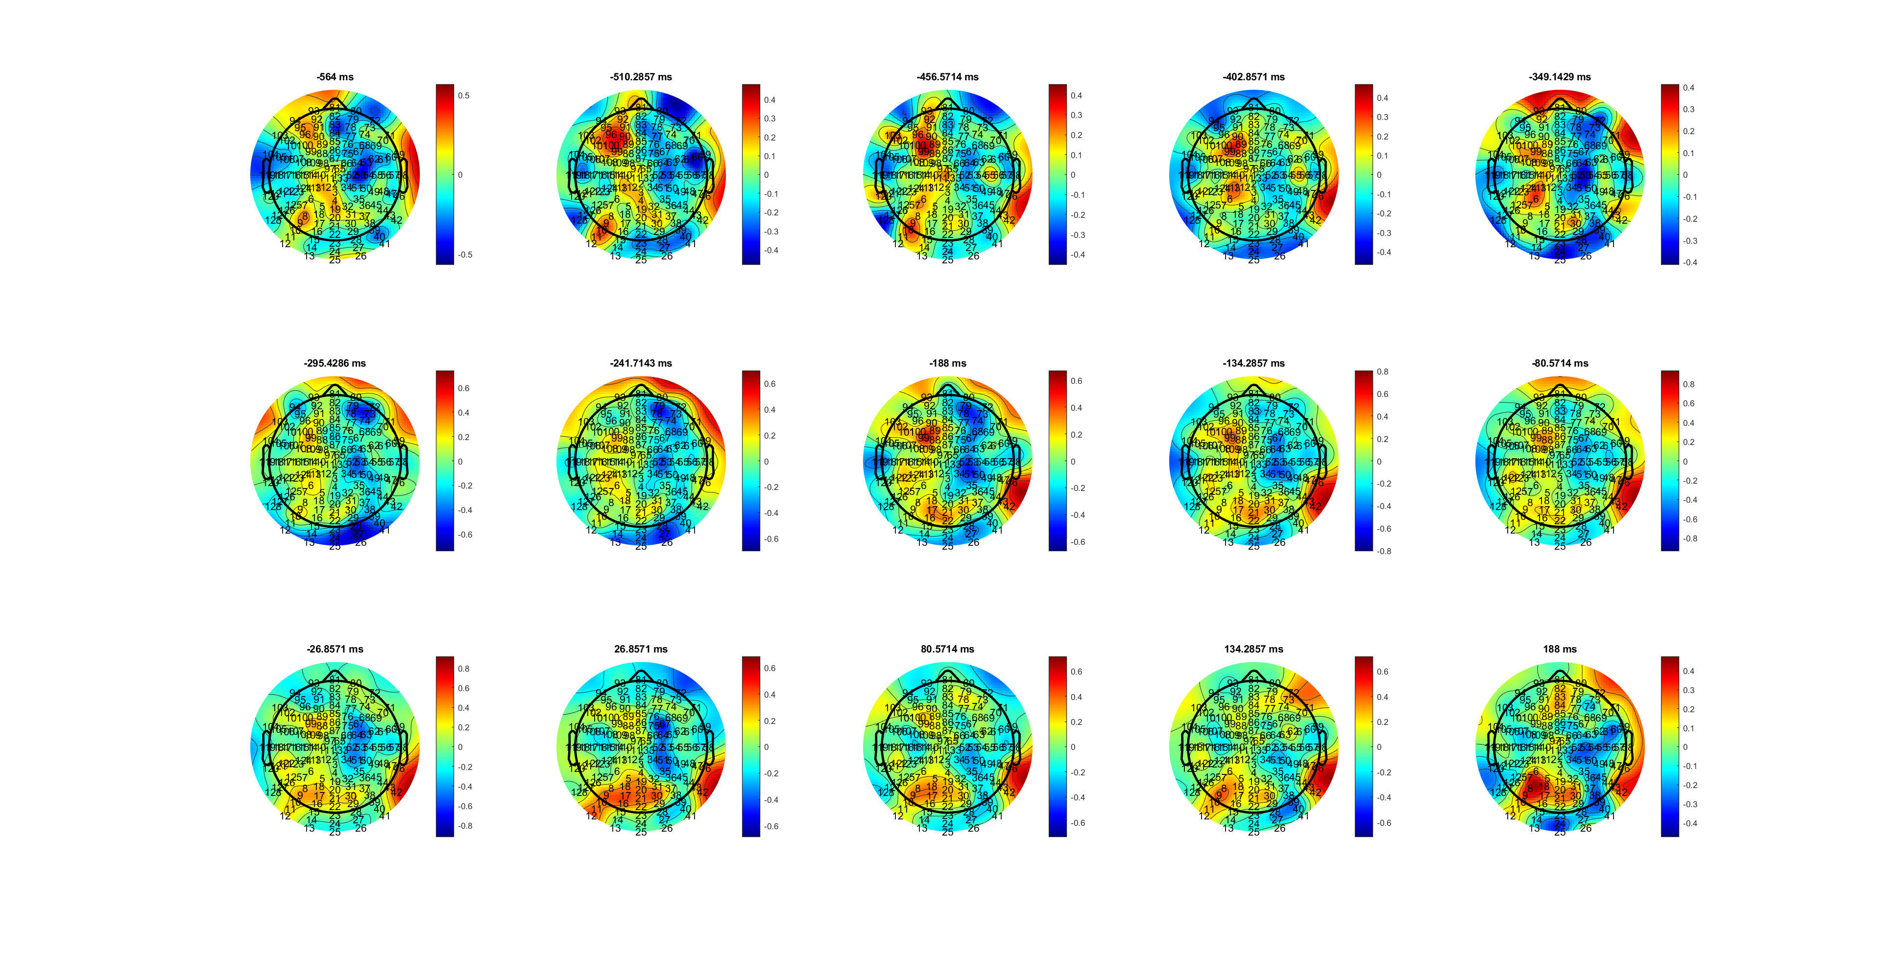
FDI
MuBeta_EOL_FDIBCP.mat
Notes:
FDI后BCP位置靠前在MuBeta
FDI反应更强持续长

Slide 40
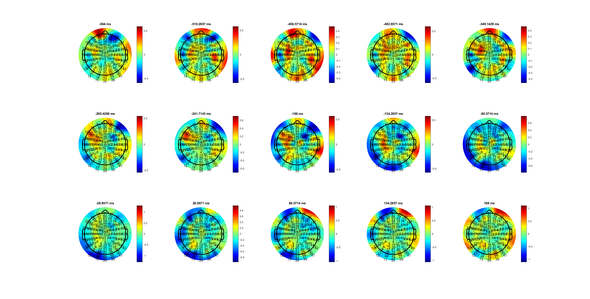
BCP
MuBeta_EOL_FDIBCP.mat

Slide 41
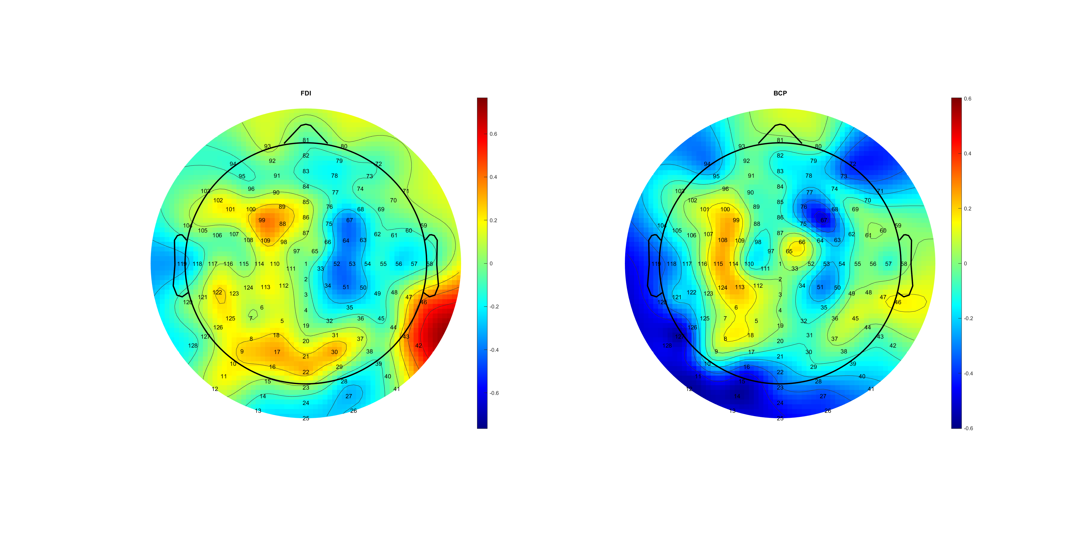
Asymmetry!
MuBeta_EOL_FDIBCP.mat

Slide 42
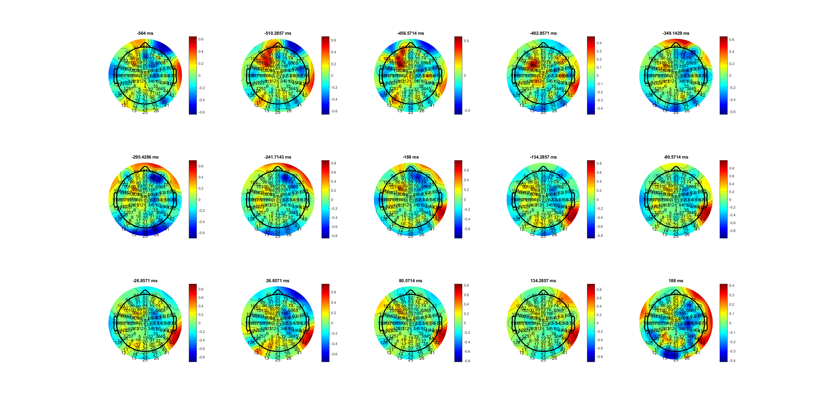
FDI
Beta_EOL_FDIBCP.mat

Slide 43
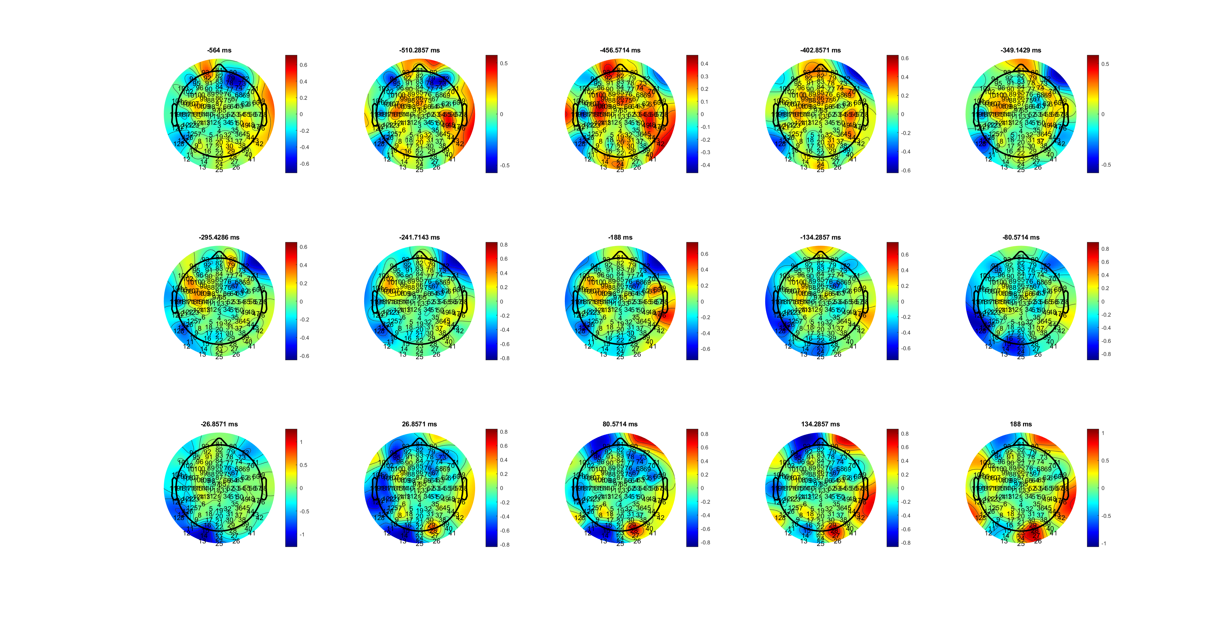
BCP
Beta_EOL_FDIBCP.mat

Slide 44
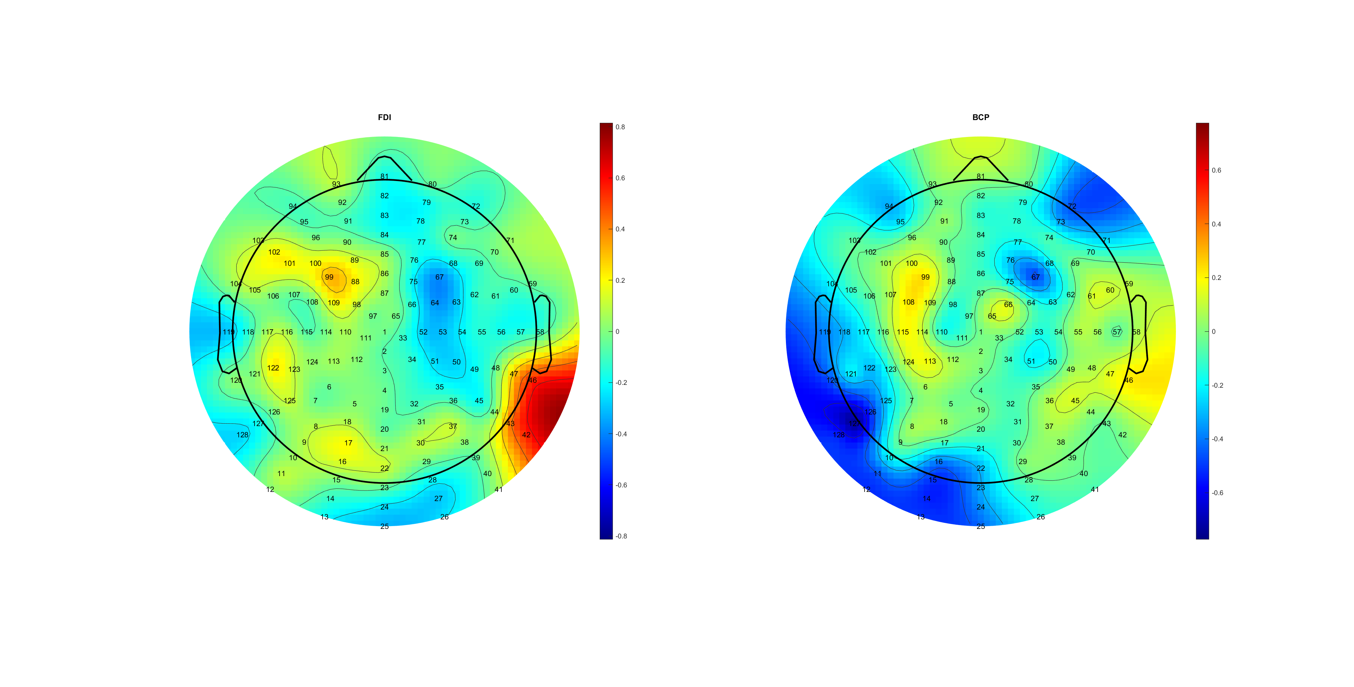
Beta_EOL_FDIBCP.mat

Slide 45
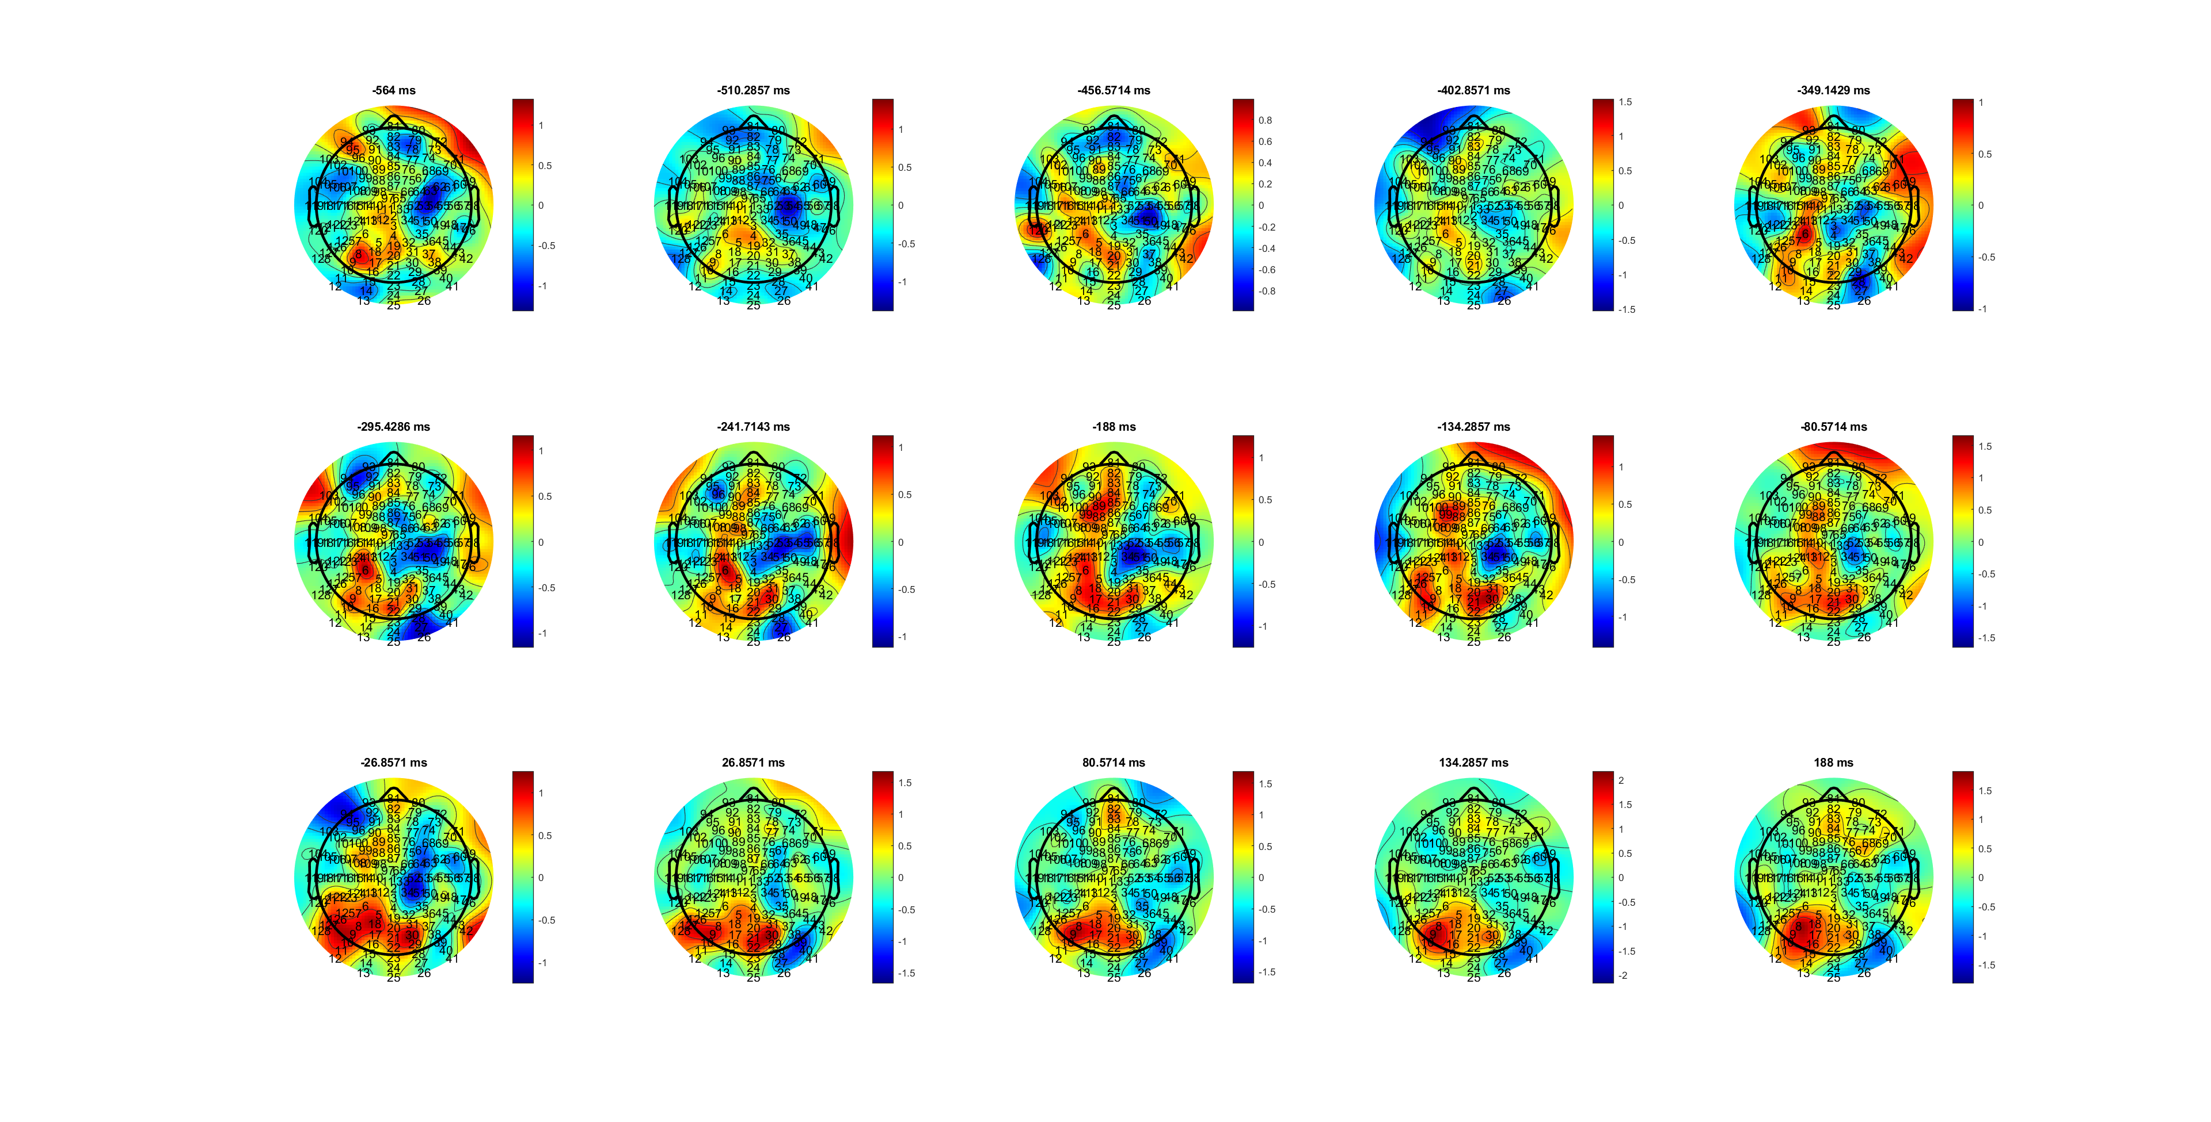
FDI
Mu_EOL_FDIBCP.mat

Slide 46
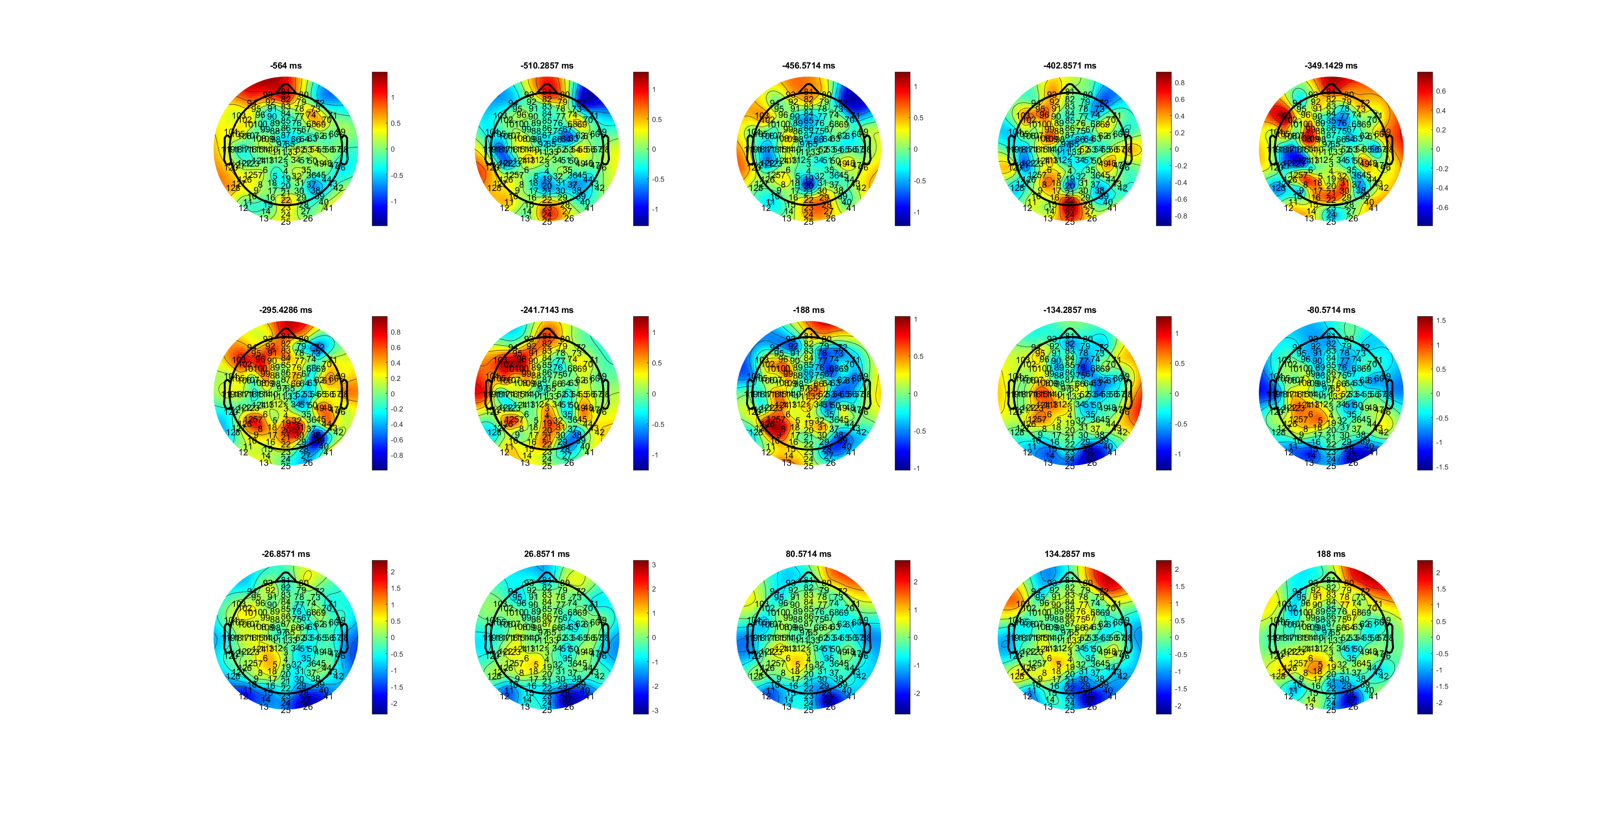
BCP
Mu_EOL_FDIBCP.mat

Slide 47
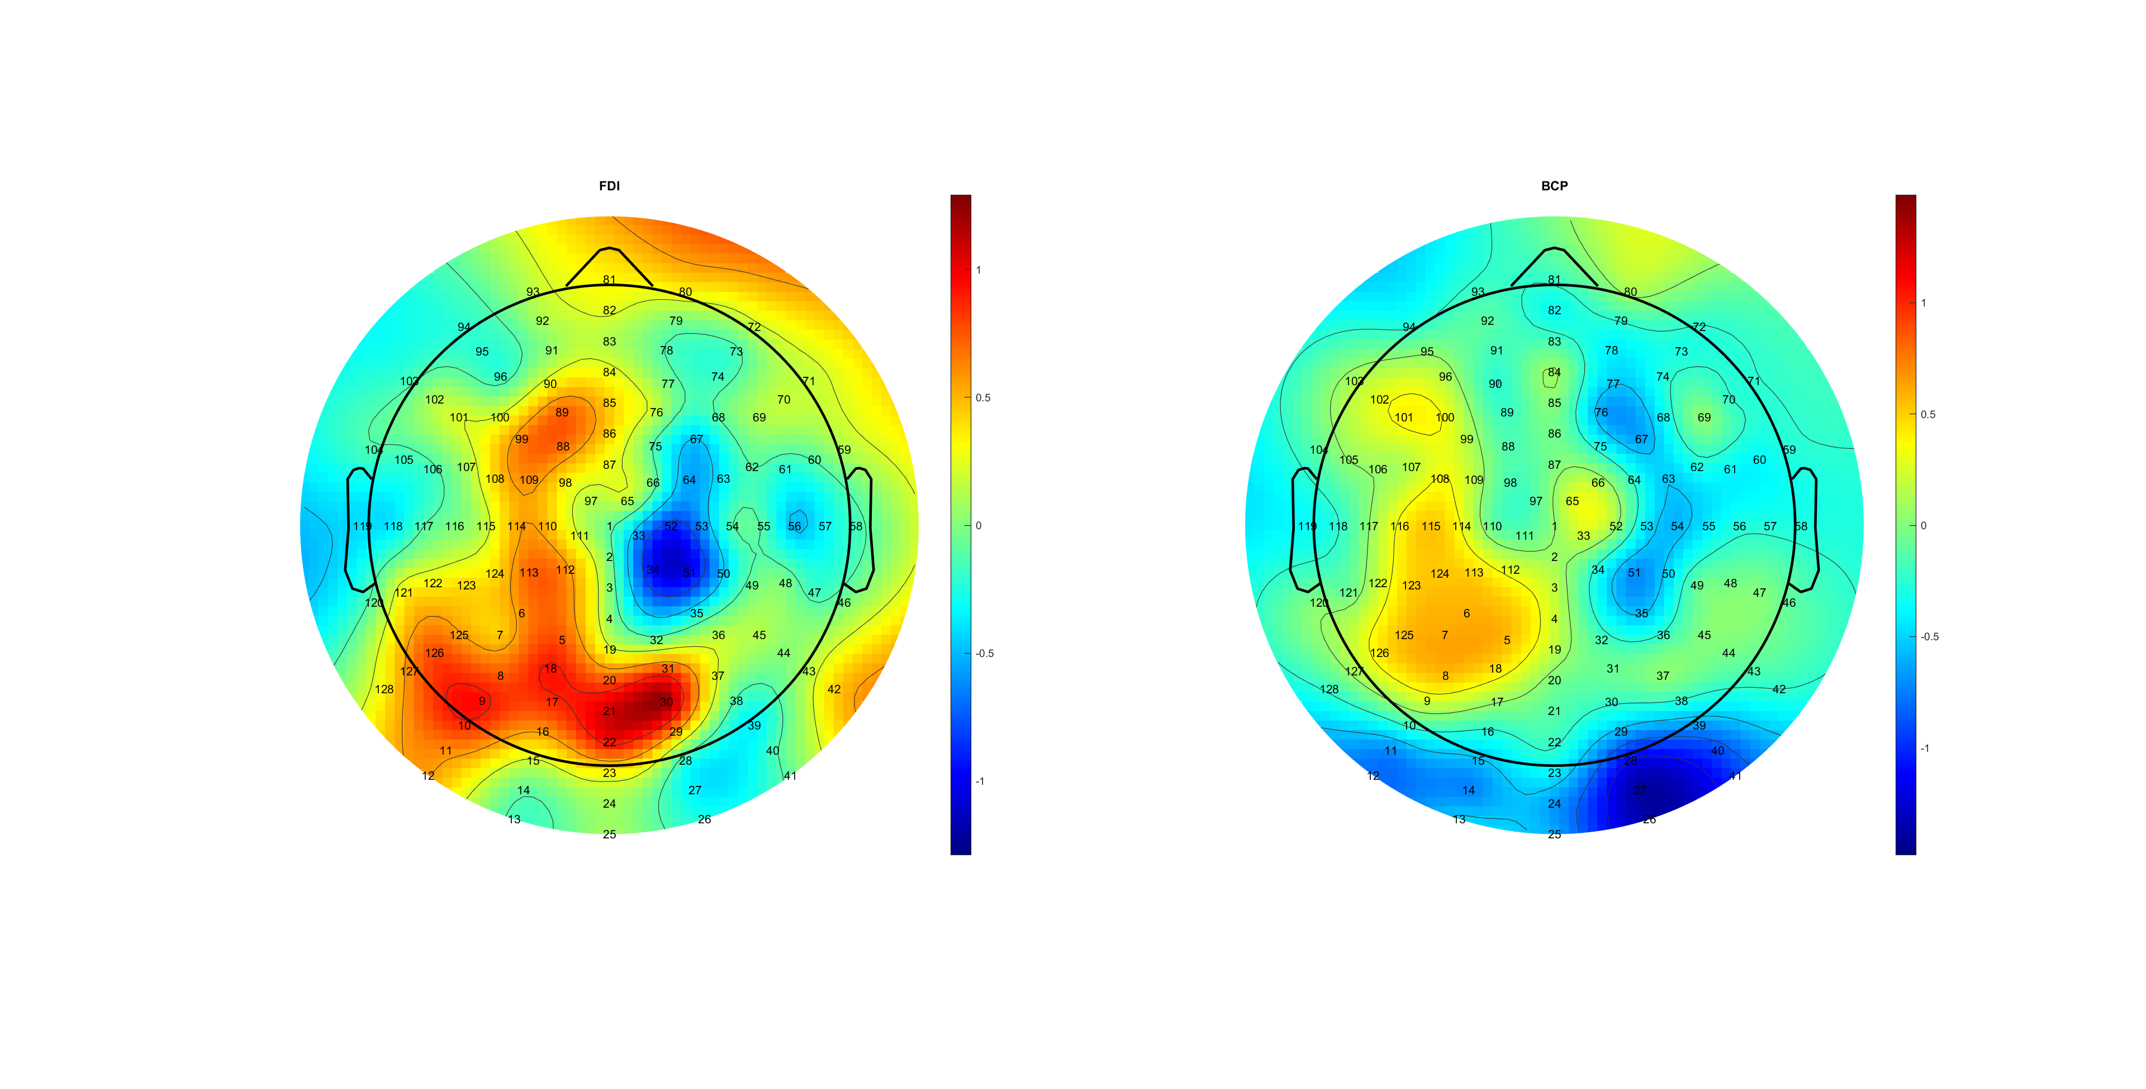
Asymmetry!
Mu_EOL_FDIBCP.mat

Slide 48
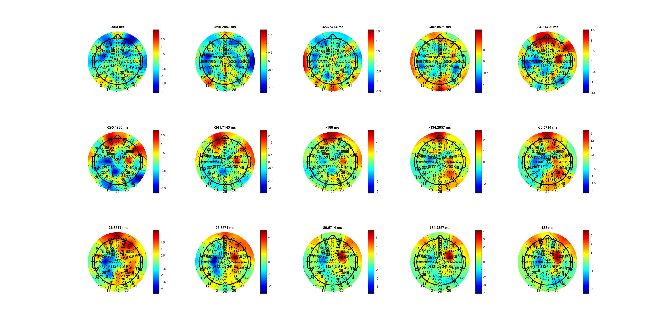
FDI
Delta_EOL_FDIBCP.mat

Slide 49
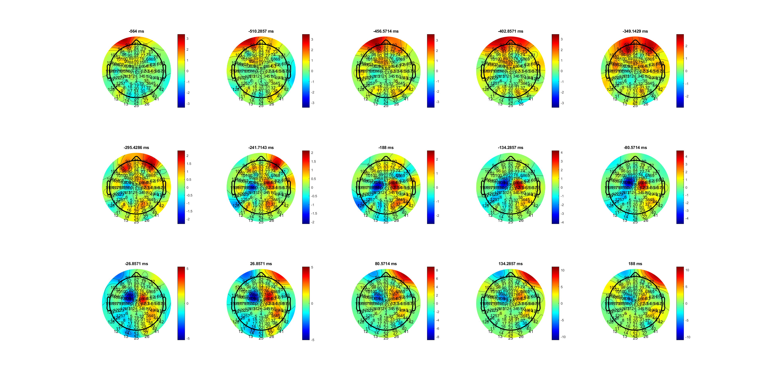
BCP
Delta_EOL_FDIBCP.mat

Slide 50
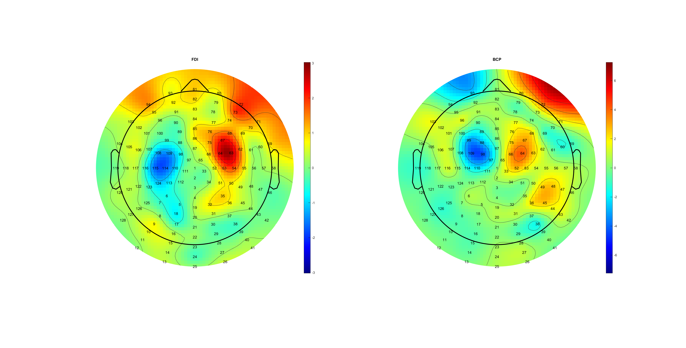
AVG C34 Asymmetry
Delta_EOL_FDIBCP.mat

Slide 51
RL

Slide 52
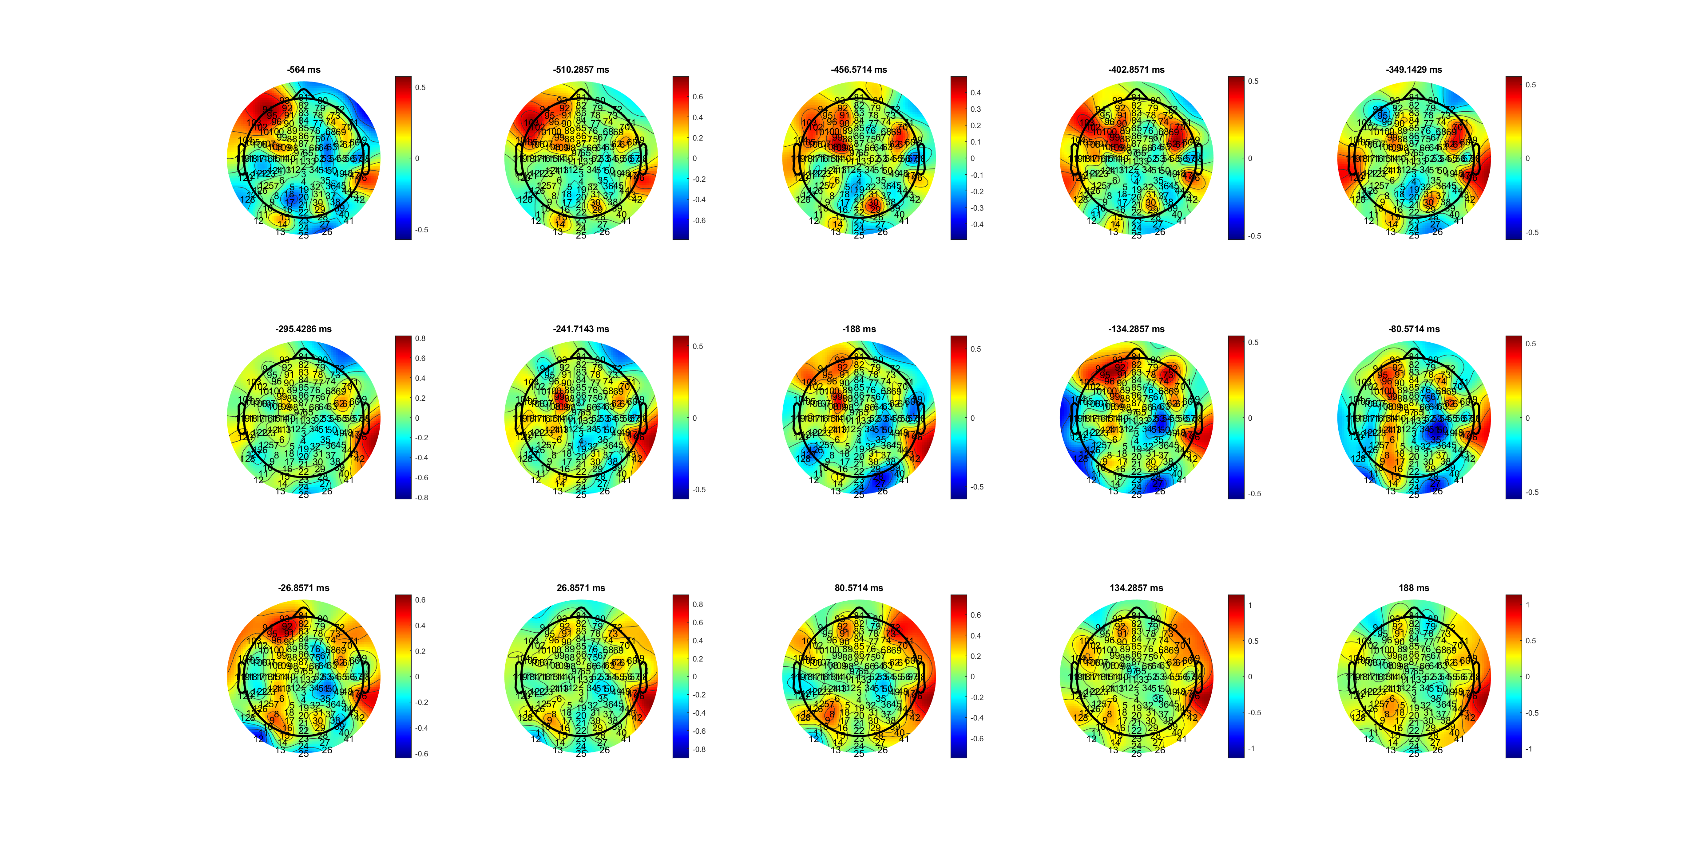
H
MuBeta_RL_HL.mat

Slide 53
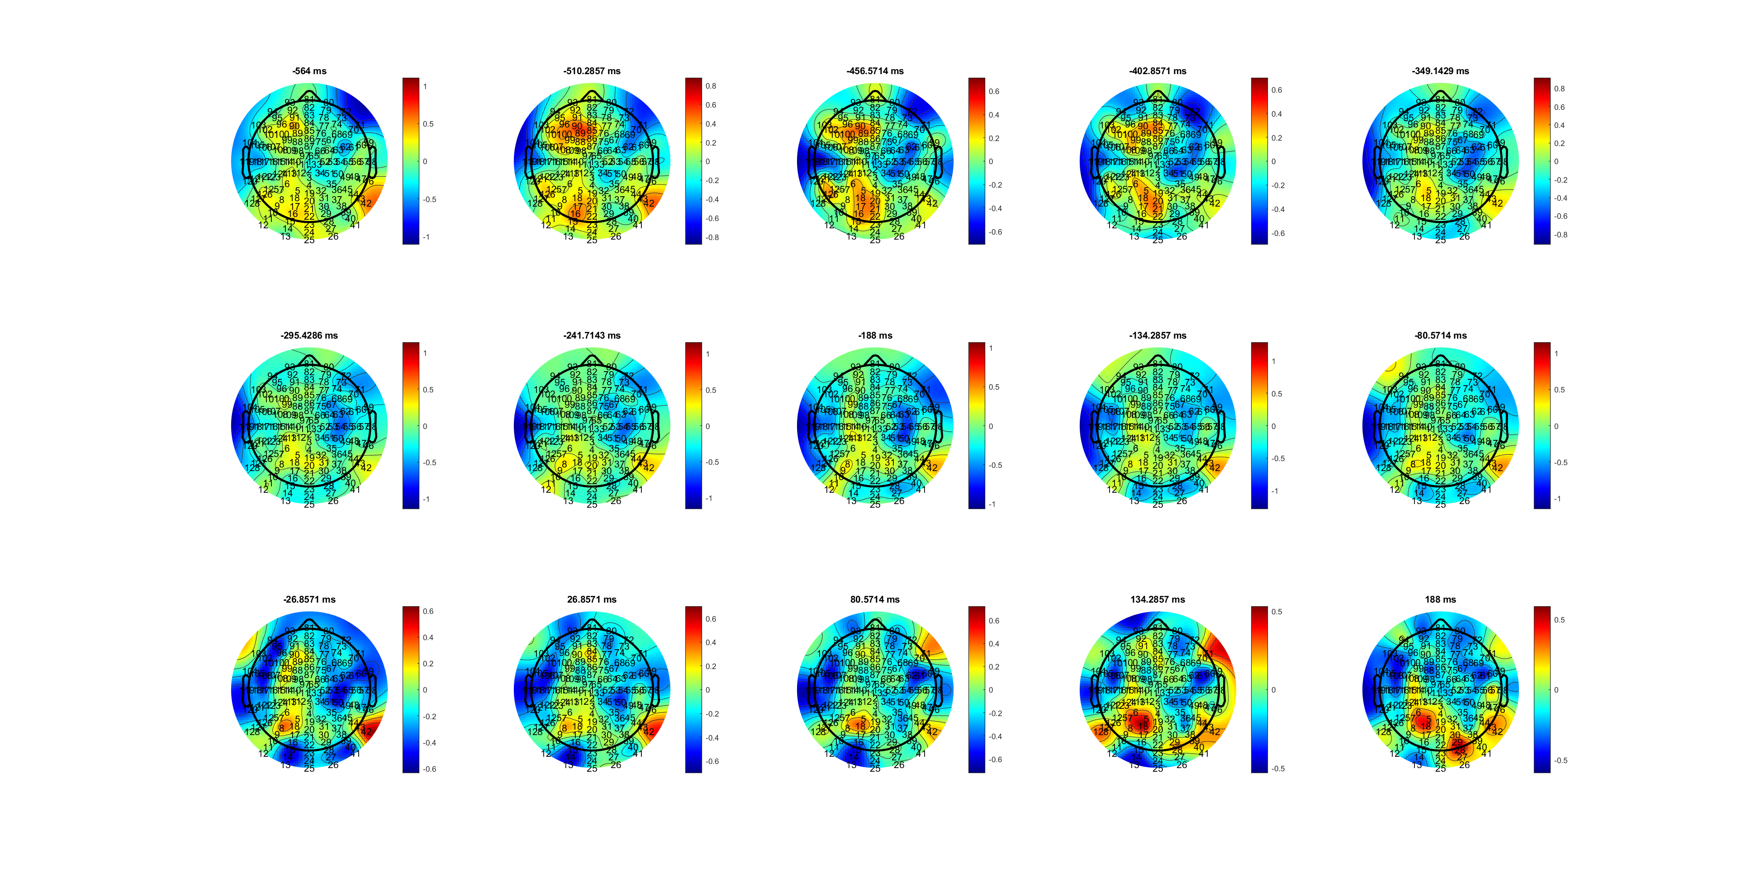
L
MuBeta_RL_HL.mat

Slide 54
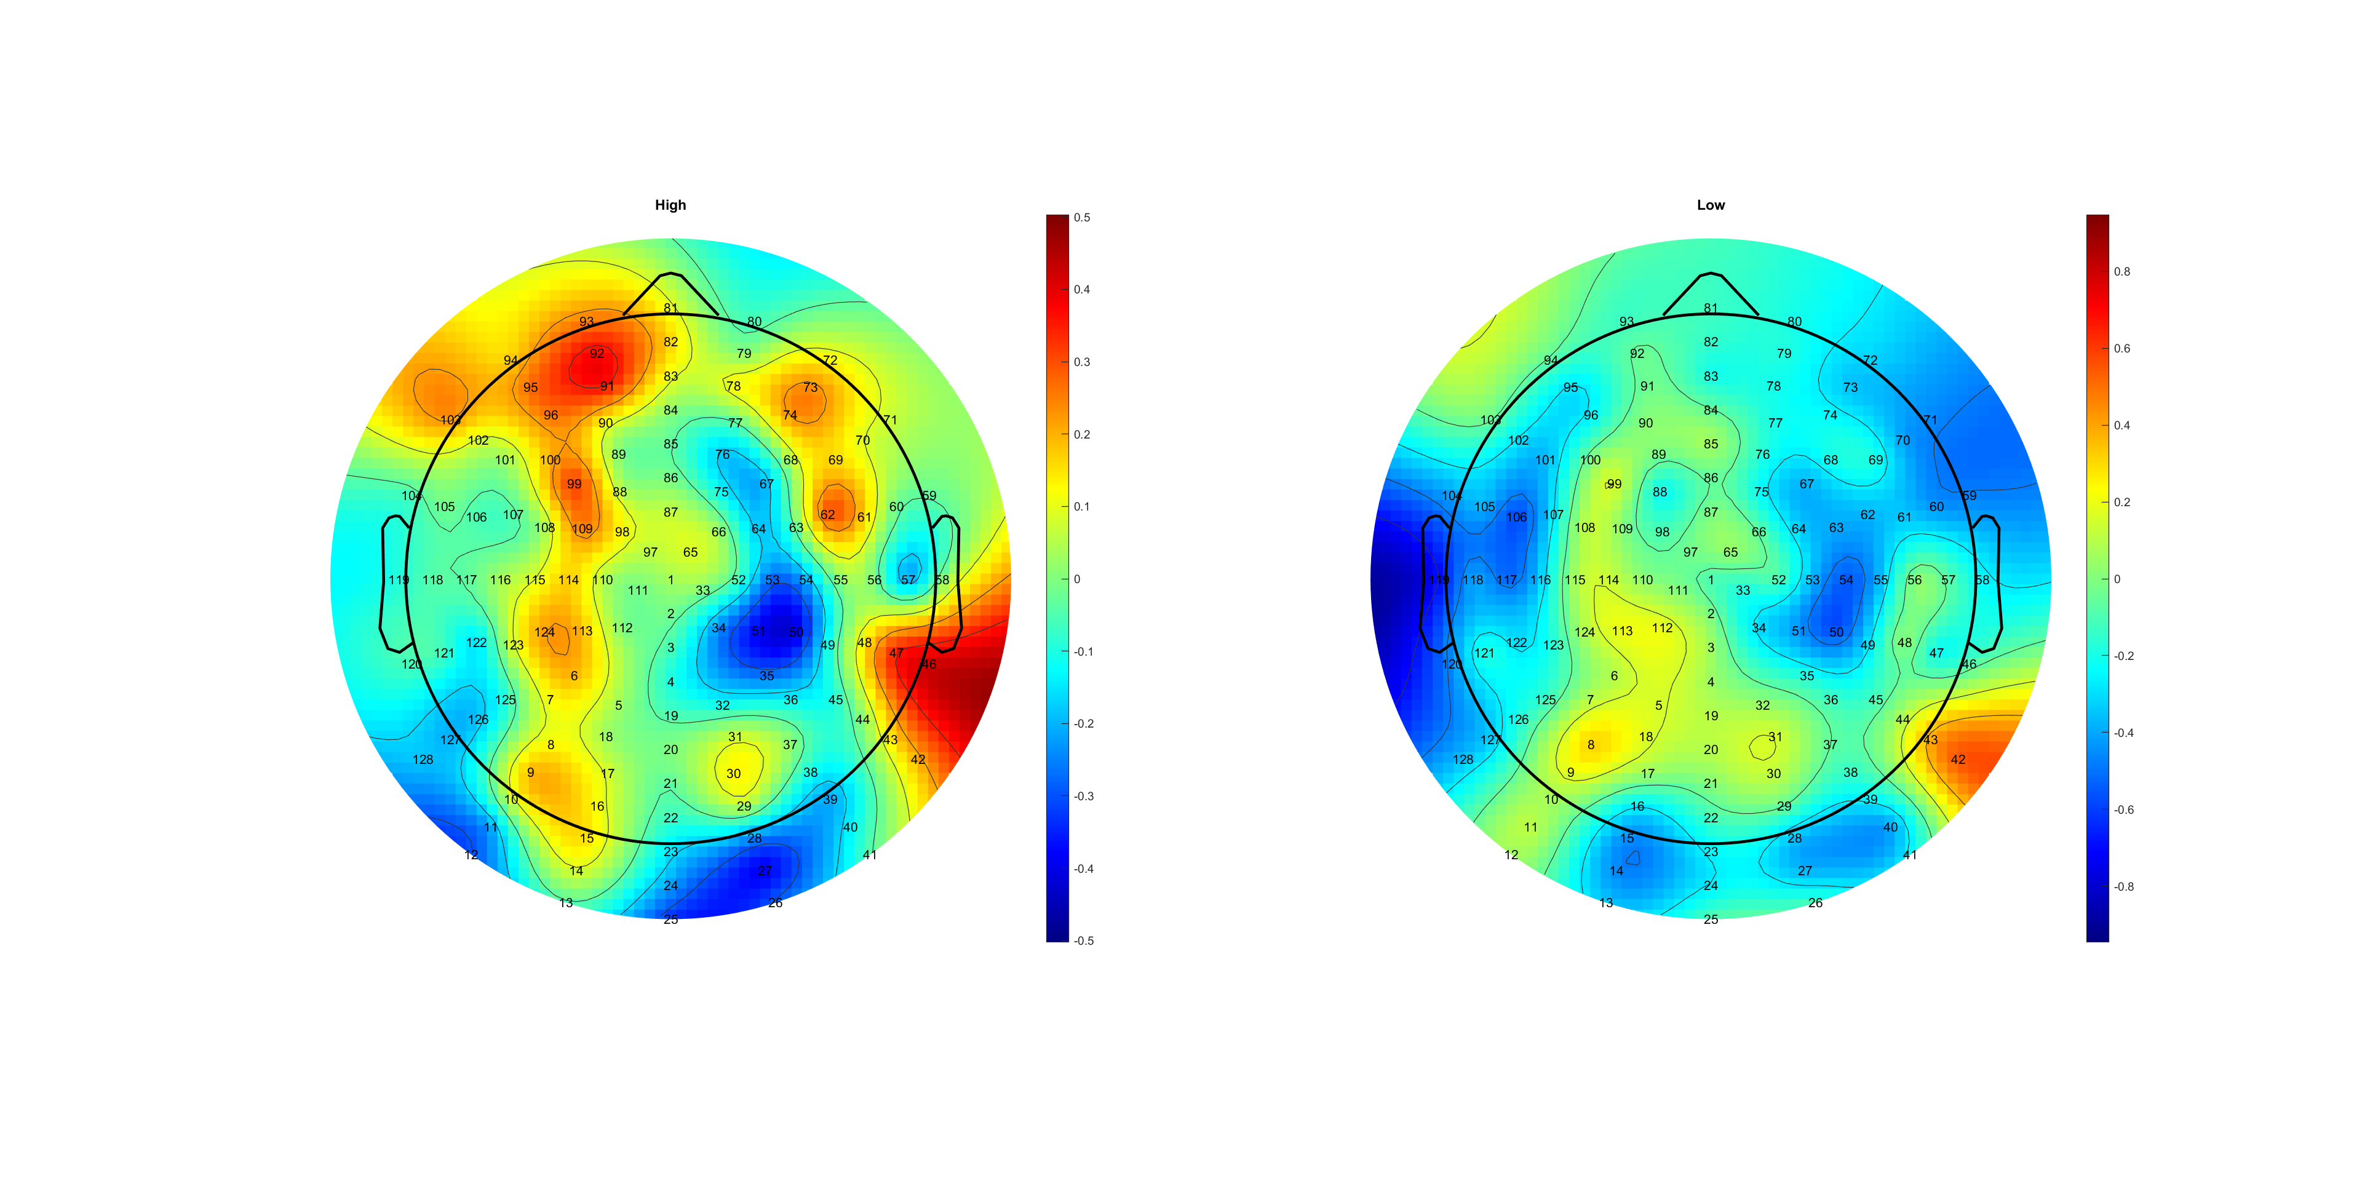
AVG C34
MuBeta_RL_HL.mat

Slide 55
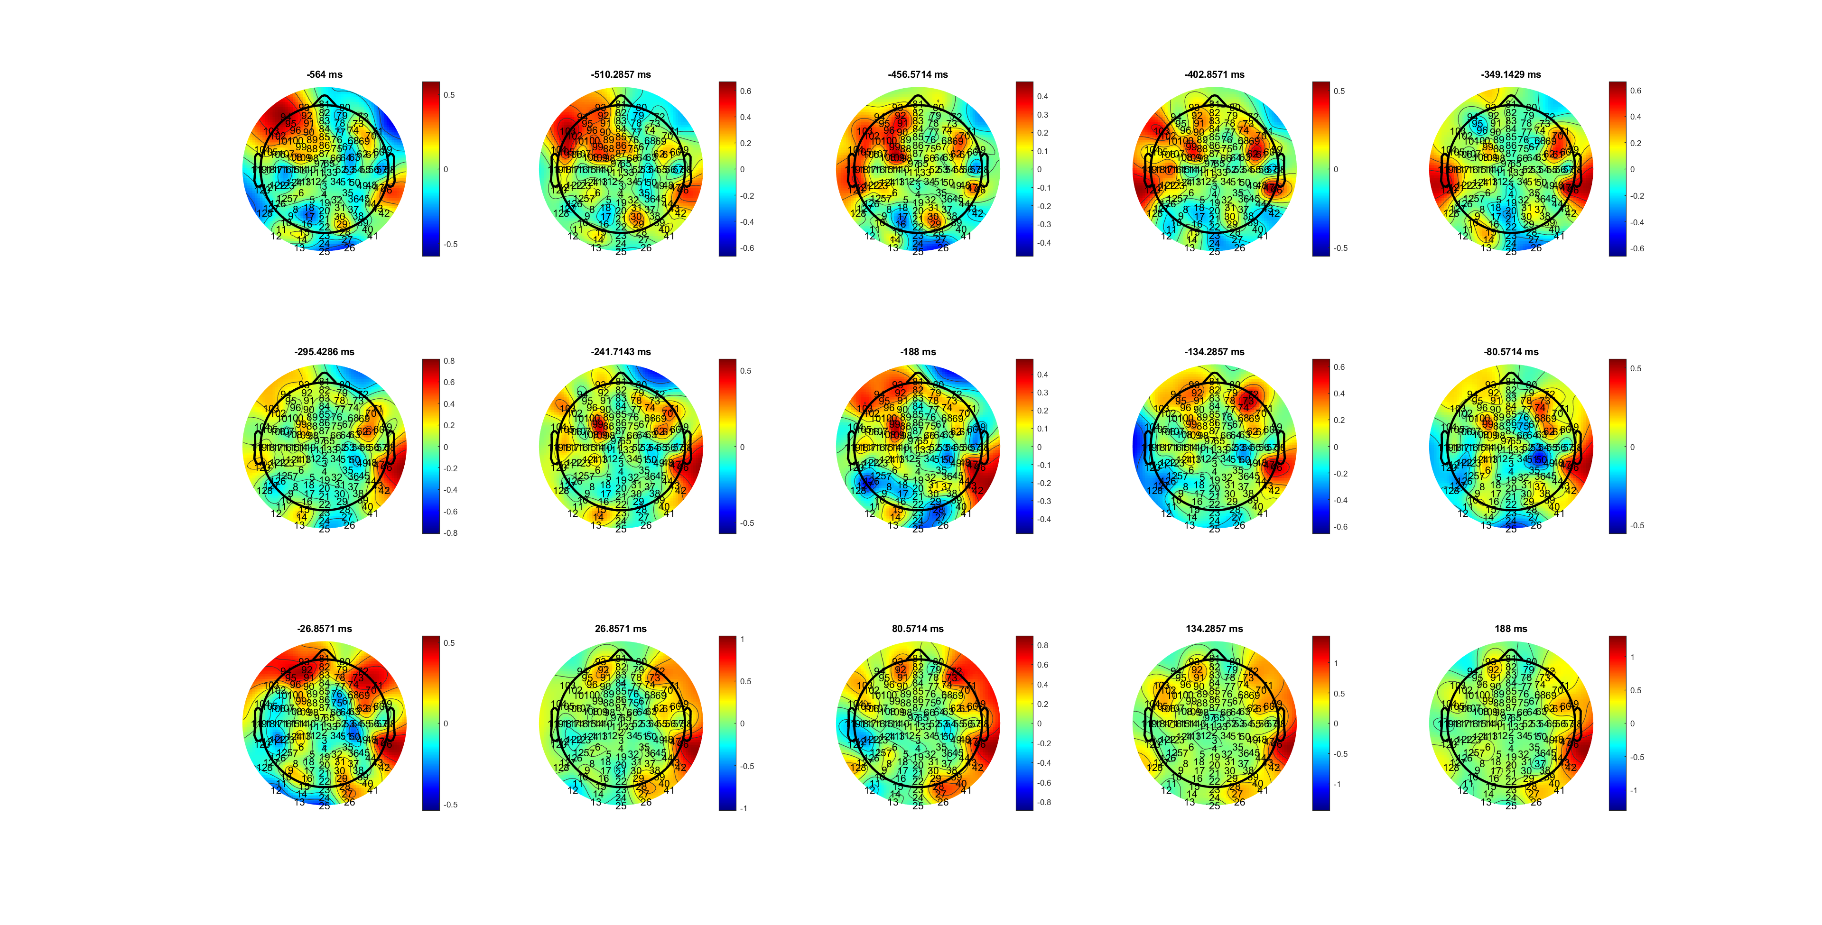
H
Beta_RL_HL.mat

Slide 56
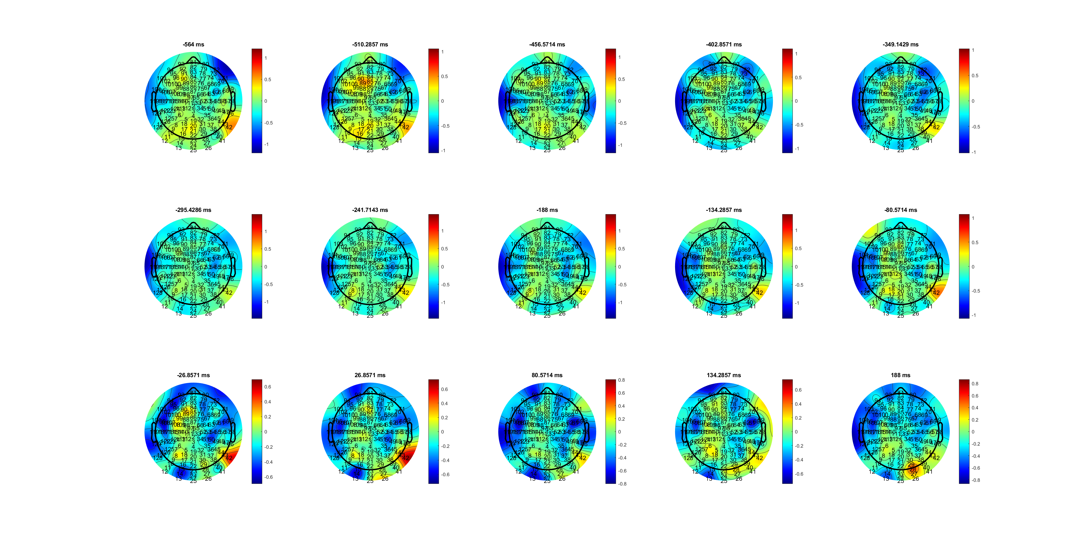
L
Beta_RL_HL.mat

Slide 57
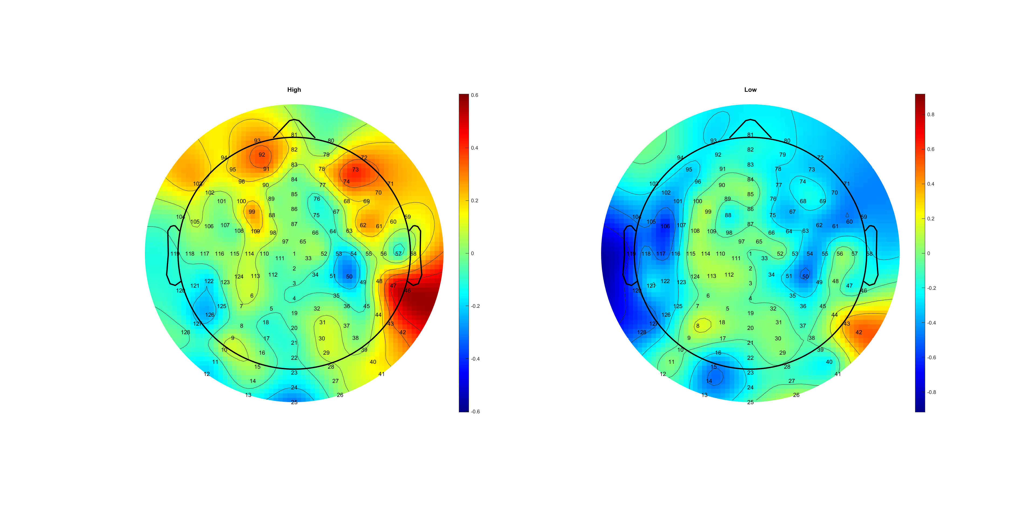
Beta_RL_HL.mat

Slide 58
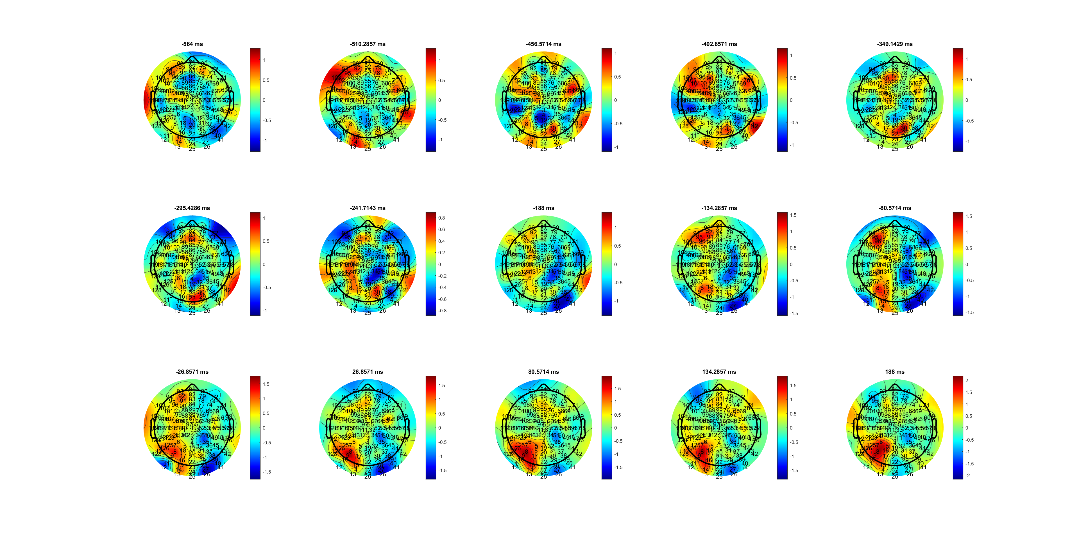
H
Mu_RL_HL.mat

Slide 59
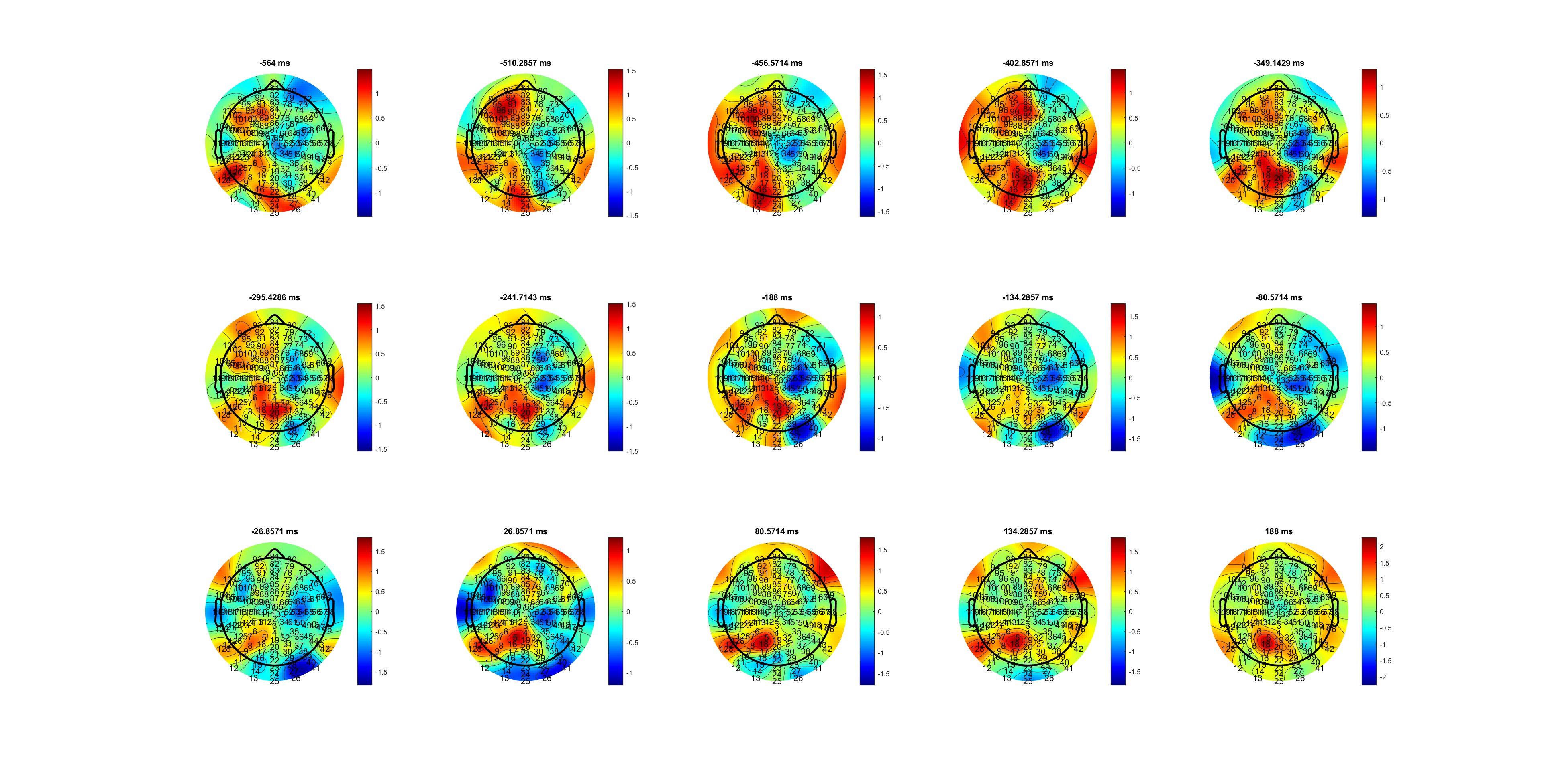
L
Mu_RL_HL.mat

Slide 60
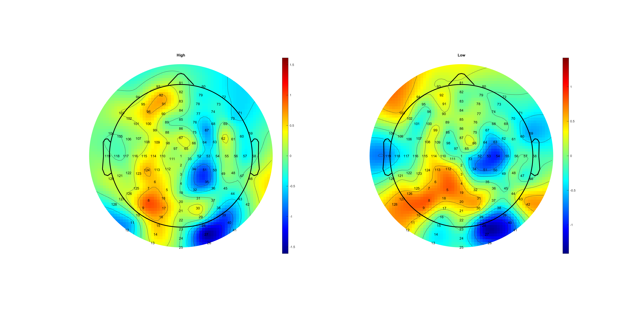
Mu_RL_HL.mat

Slide 61
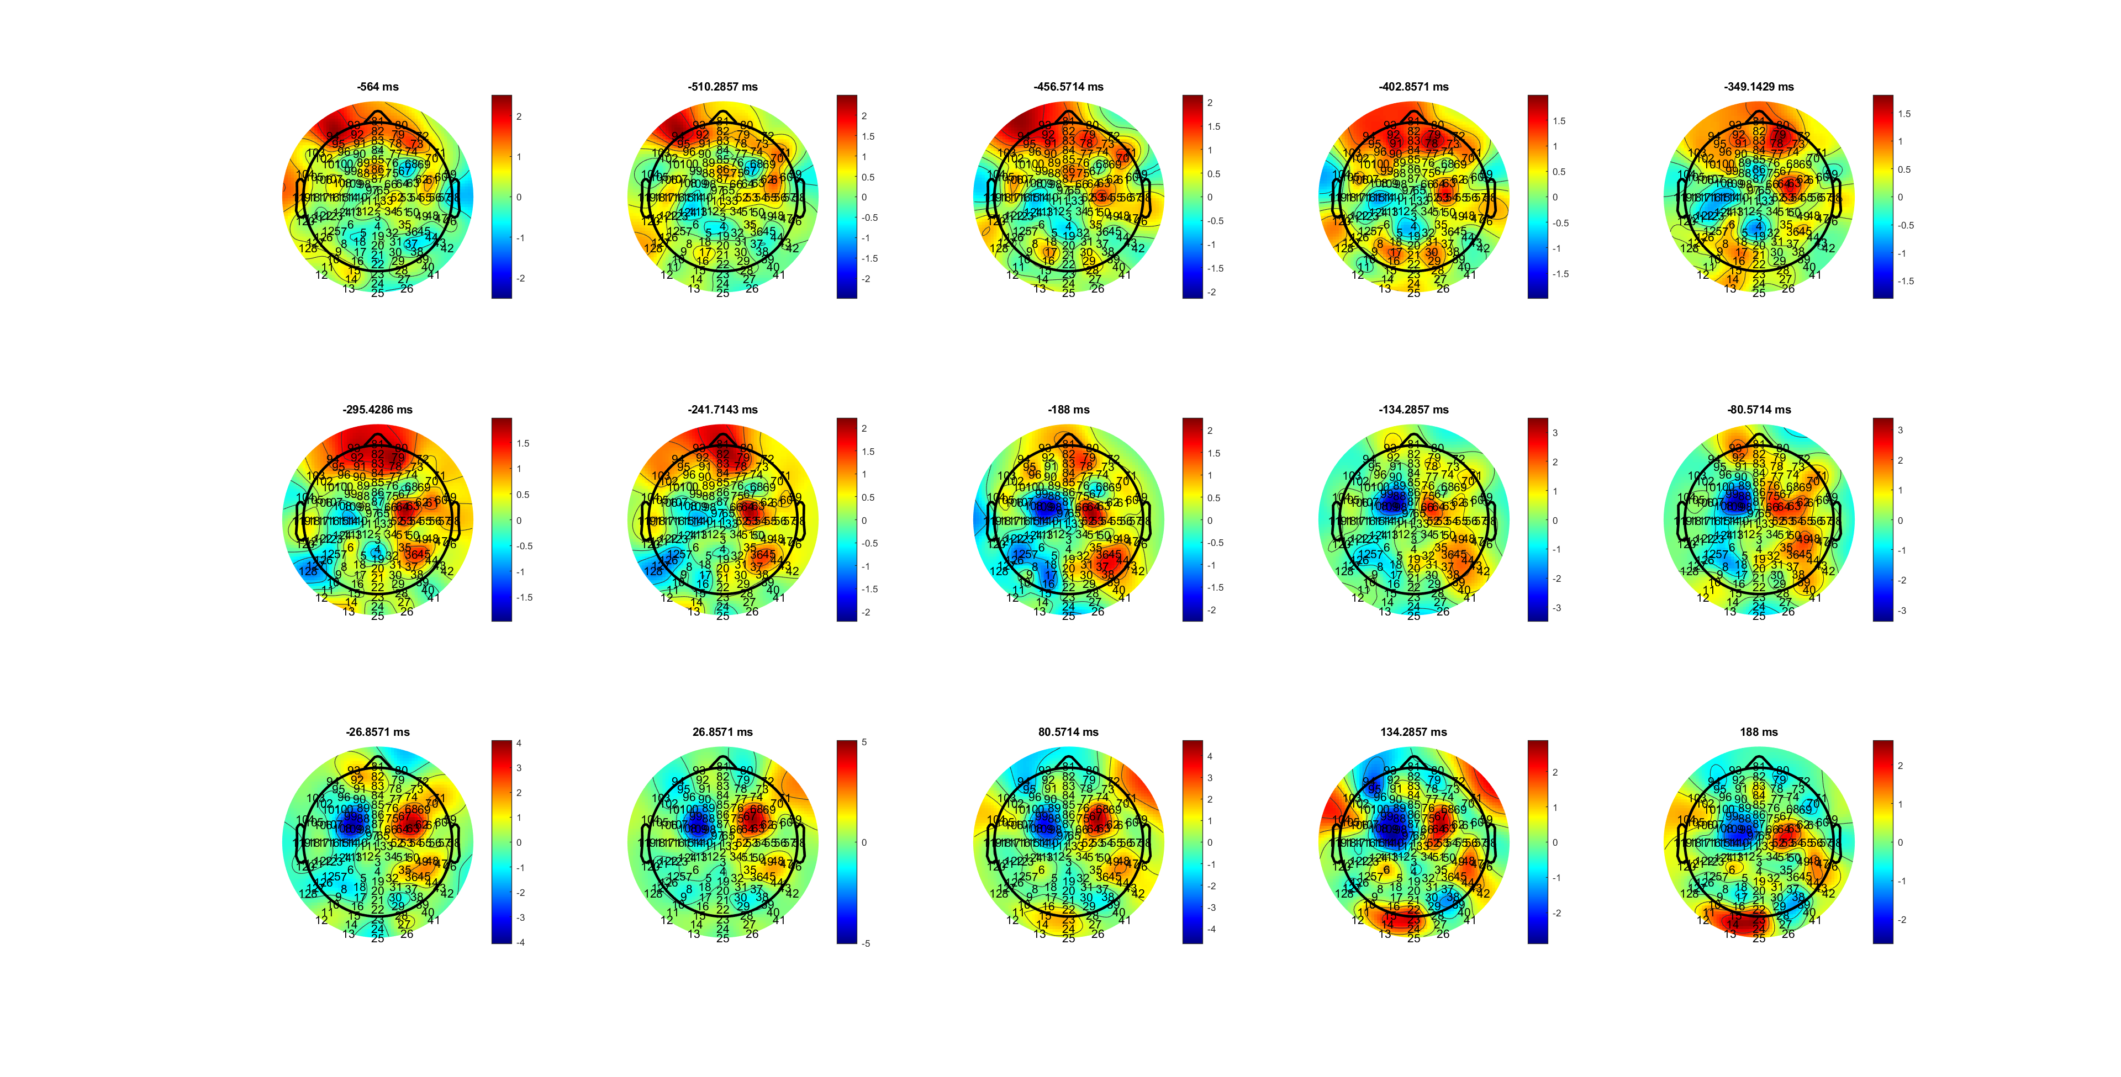
H
Delta_RL_HL.mat

Slide 62
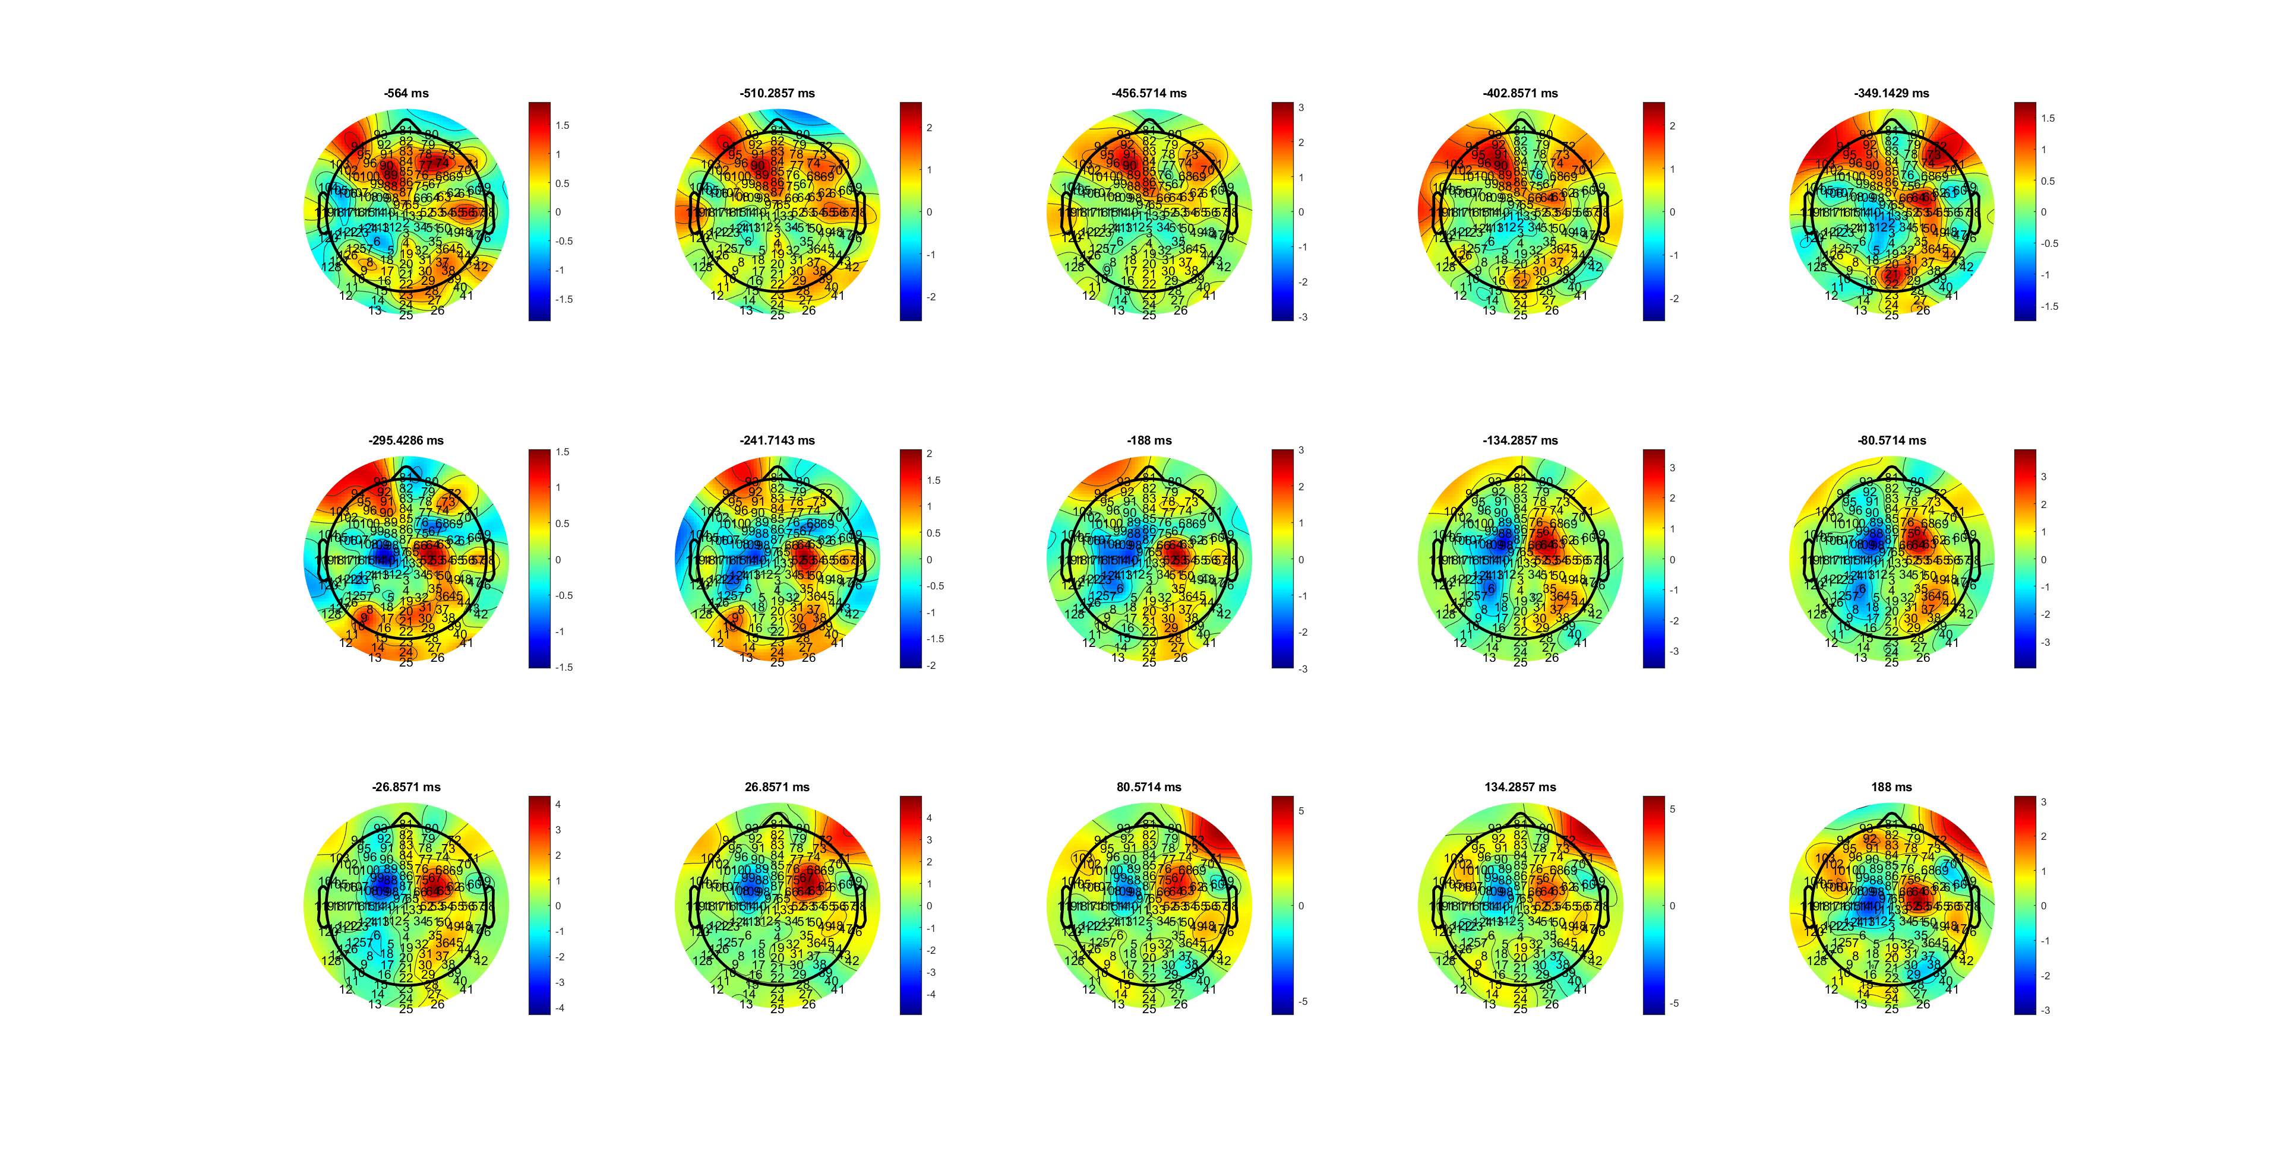
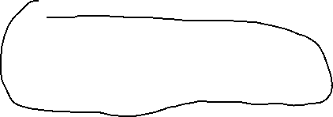

L
Delta_RL_HL.mat

Slide 63
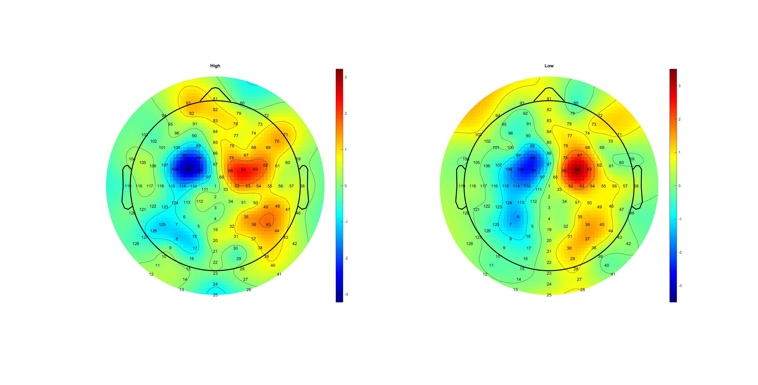
Diff slop
Delta_RL_HL.mat

Slide 64
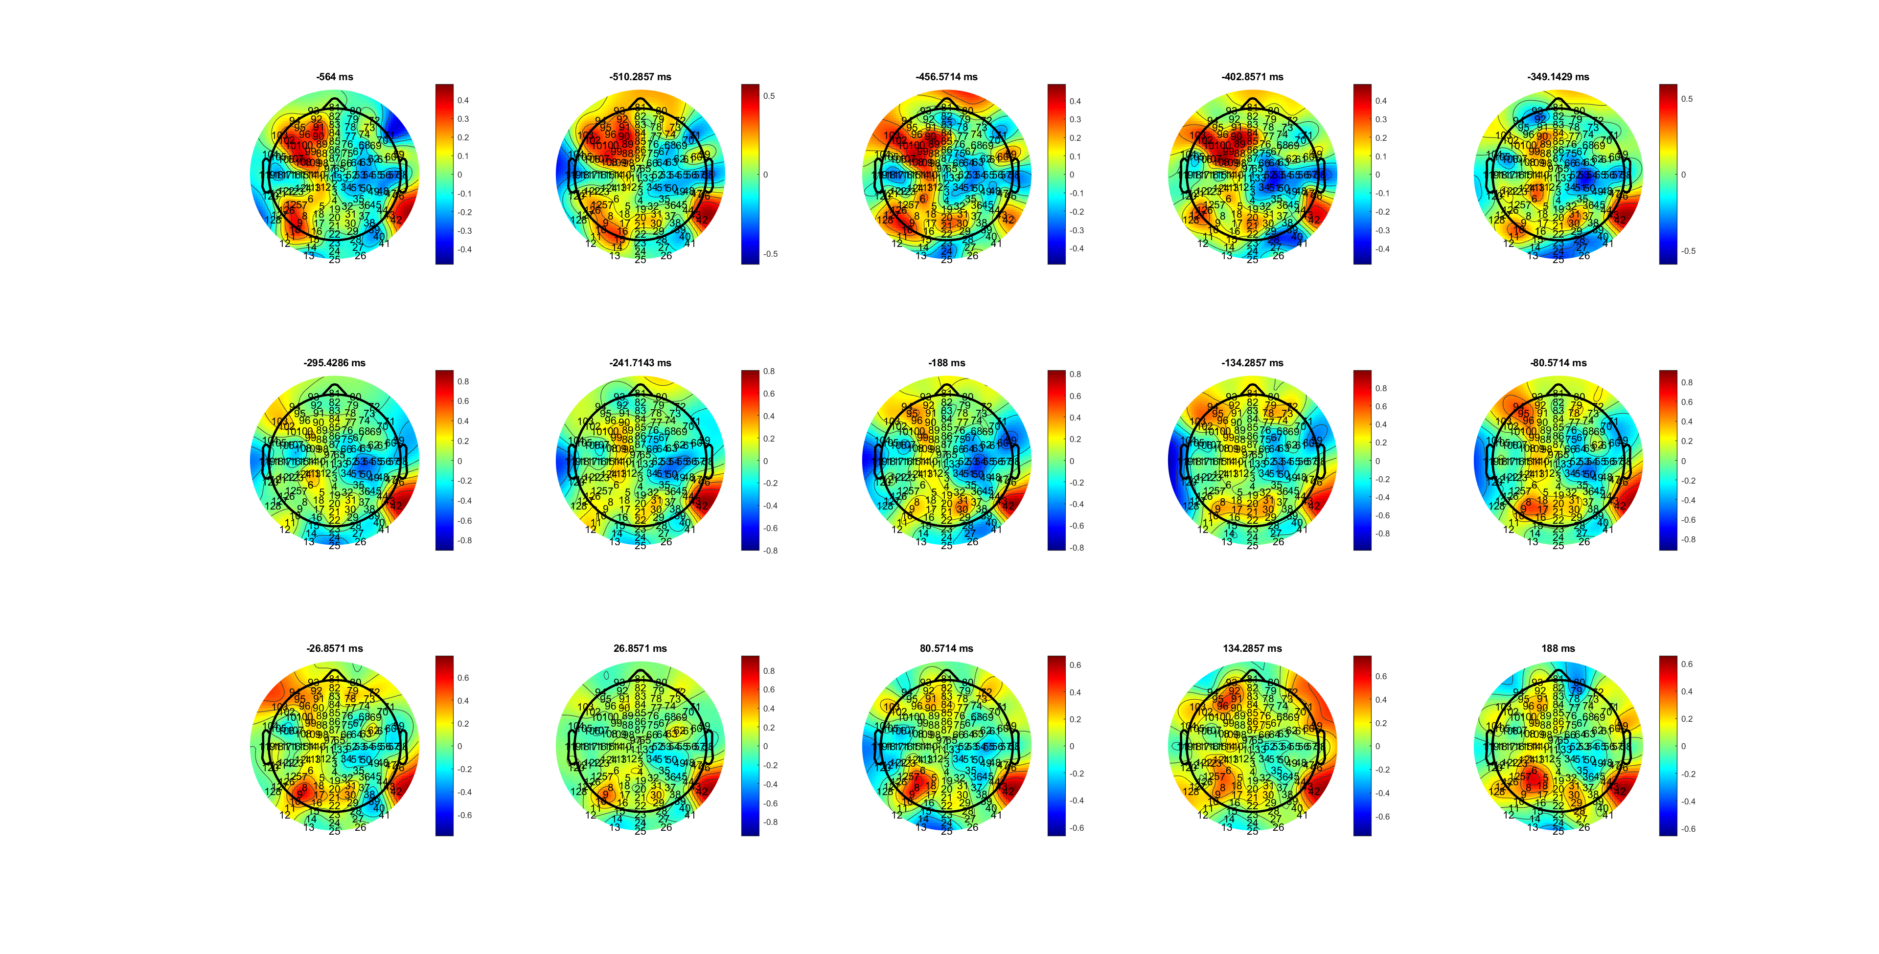


FDI
MuBeta_RL_FDIBCP.mat

Slide 65


BCP
MuBeta_RL_FDIBCP.mat

Slide 66

Asymmetry
MuBeta_RL_FDIBCP.mat

Slide 67

FDI
Beta_RL_FDIBCP.mat

Slide 68

BDP
Beta_RL_FDIBCP.mat

Slide 69

Beta_RL_FDIBCP.mat

Slide 70

FDI
Mu_RL_FDIBCP.mat

Slide 71

BCP
Mu_RL_FDIBCP.mat

Slide 72

Mu_RL_FDIBCP.mat

Slide 73






FDI
Delta_RL_FDIBCP.mat

Slide 74

BCP
Delta_RL_FDIBCP.mat

Slide 75

Diff slop, diff end point/ turning point
Delta_RL_FDIBCP.mat

